Slide 1
TexPoint fonts used in EMF.
Read the TexPoint manual before you delete this box.: AAAAAAAAAAAAAAAA
Notes:
Dear State Secretary, dear Vice President, dear Colleagues,
It is my great pleasure to welcome you on behalf of the Local Organising Committee and the entire Organisation Team
to this year’s International Symposium on Lattice Field Theory, Lattice 2013.
We are really pleased to see so many of you here in Mainz. In fact, we’ve had a record attendance this year. The impressive number of 510 participants shows that our field is really thriving. Some of you may have noticed the camera team, and I’m happy to say that the opening of the conference will be featured on the national news today at lunchtime.
The strong attendance figure, of course, resulted in something of a logistical challenge. The most difficult part was to accommodate all the parallel talks. You may have noticed that we will be running up to 7 sessions in parallel, which is perhaps the maximum number that is still manageable.
We are also pleased to welcome representatives from the Ministry for Science and Education and the University Management, and I’d now like to hand over to State Secretary Vera Reiss.

Slide 2
31st International Symposium on
Lattice Field Theory
Vera Reiß
State Ministry of Education and Science, Rhineland-Palatinate
Conference Opening
TexPoint fonts used in EMF.
Read the TexPoint manual before you delete this box.: AAAAAAAAAAAAAAAA

Slide 3
31st International Symposium on
Lattice Field Theory
Professor Wolfgang Hofmeister
Vice President for Research, Johannes Gutenberg University
Conference Opening
TexPoint fonts used in EMF.
Read the TexPoint manual before you delete this box.: AAAAAAAAAAAAAAAA

Slide 4
TexPoint fonts used in EMF.
Read the TexPoint manual before you delete this box.: AAAAAAAAAAAAAAAA
Notes:
Despite all the good news about our field, there were also several sad events that our community was confronted with.

Slide 5
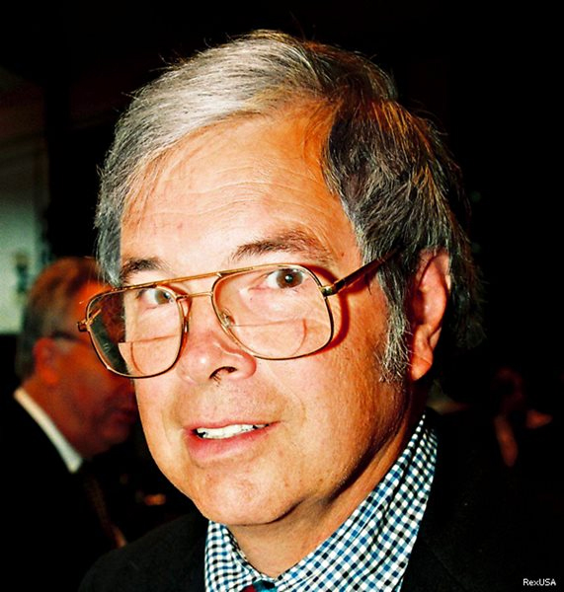
Kenneth G. Wilson
THU 11:45 Kenneth G. Wilson; Obituary & Award Announcement
(Andreas Kronfeld)
1936 – 2013
TexPoint fonts used in EMF.
Read the TexPoint manual before you delete this box.: AAAAAAAAAAAAAAAA
Notes:
On the 15th of June this year, Nobel Laureate Ken Wilson – the main founder of lattice field theory – sadly passed away. There can be no doubt that Ken Wilson was one of the most influential theoretical physicists of the 20th century, whose ideas have led to breakthroughs in many different areas of field theory, particle and condensed matter physics. Without his insights and creativity, we would not be sitting here today.
A full scientific obituary will be given by Andreas Kronfeld in the Thursday plenary session, after which Andreas will also announce the winner of this year’s Kenneth G. Wilson Award.
Moreover, the proceedings of Lattice 2013 will be dedicated to Ken Wilson’s memory.

Slide 6
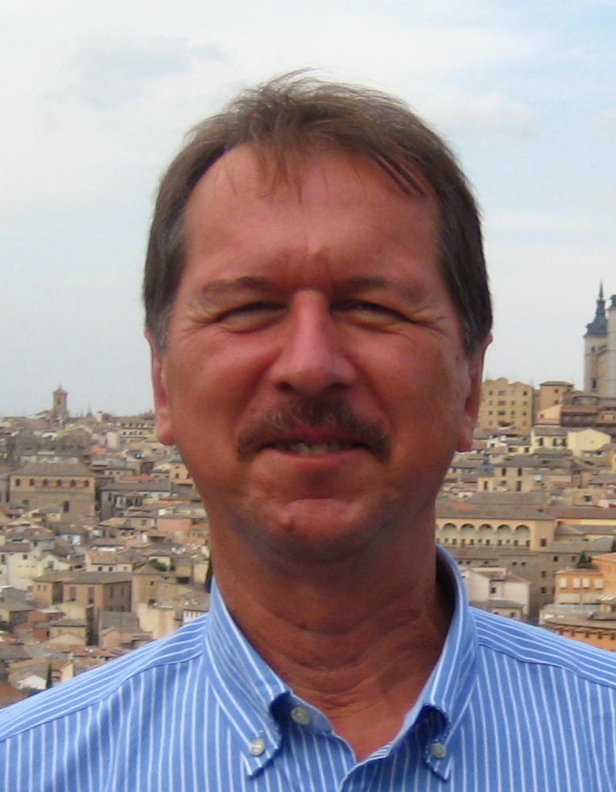
WED 8:30, Session 5E: “In memory of Mikhail Polikarpov”
Mikhail Polikarpov
(Vitaly Bornyakov & Pavel Buividovich)
1951 – 2013
TexPoint fonts used in EMF.
Read the TexPoint manual before you delete this box.: AAAAAAAAAAAAAAAA
Notes:
Our community has been hit by yet another tragic event, namely the sudden and completely unexpected death of our colleague Misha Polikarpov on 18th of July, i.e. less than two weeks ago.
Misha was instrumental in setting up the lattice group at ITEP Moscow, and he can be credited not only with many original ideas, but also with the discovery of many young talents in lattice field theory. He will be sorely missed.
Misha was due to give a talk in the parallel sessions this year. Vitaly Bornyakov and Pavel Buividovich will take his place to present an obituary to honour Misha’s life and achievements.

Slide 7
TexPoint fonts used in EMF.
Read the TexPoint manual before you delete this box.: AAAAAAAAAAAAAAAA
Notes:
I do not want to take too much of the precious time devoted to our scientific programme, but I would really like to thank our sponsors and supporters.
It was our aim to keep the conference fee at a relatively low level and to enable the younger members of our community to attend the conference during a time when financial crises have led to severe cuts in the science budgets of many countries.
This goal could only be achieved thanks to the generous financial support we received from our sponsors.

Slide 8
Sponsors and Supporters
TexPoint fonts used in EMF.
Read the TexPoint manual before you delete this box.: AAAAAAAAAAAAAAAA

Slide 9
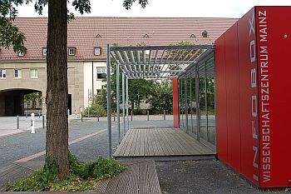
Some practical information
Conference office – “Info Box”
Conference badge
Public transportation ticket
Admission ticket for social events
Conference brochure
Parallel sessions
Please upload your presentation at least one hour prior to the start of your parallel session!
TexPoint fonts used in EMF.
Read the TexPoint manual before you delete this box.: AAAAAAAAAAAAAAAA
Notes:
Let me end with some more practical information…

Slide 10
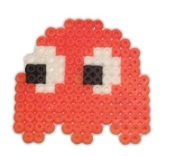
TexPoint fonts used in EMF.
Read the TexPoint manual before you delete this box.: AAAAAAAAAAAAAAAA
Notes:
Here is our conference logo again. Some people have actually tried to scan it with their mobile phones. In fact, it can be used for many different things, and something we came up with is this…

Slide 11
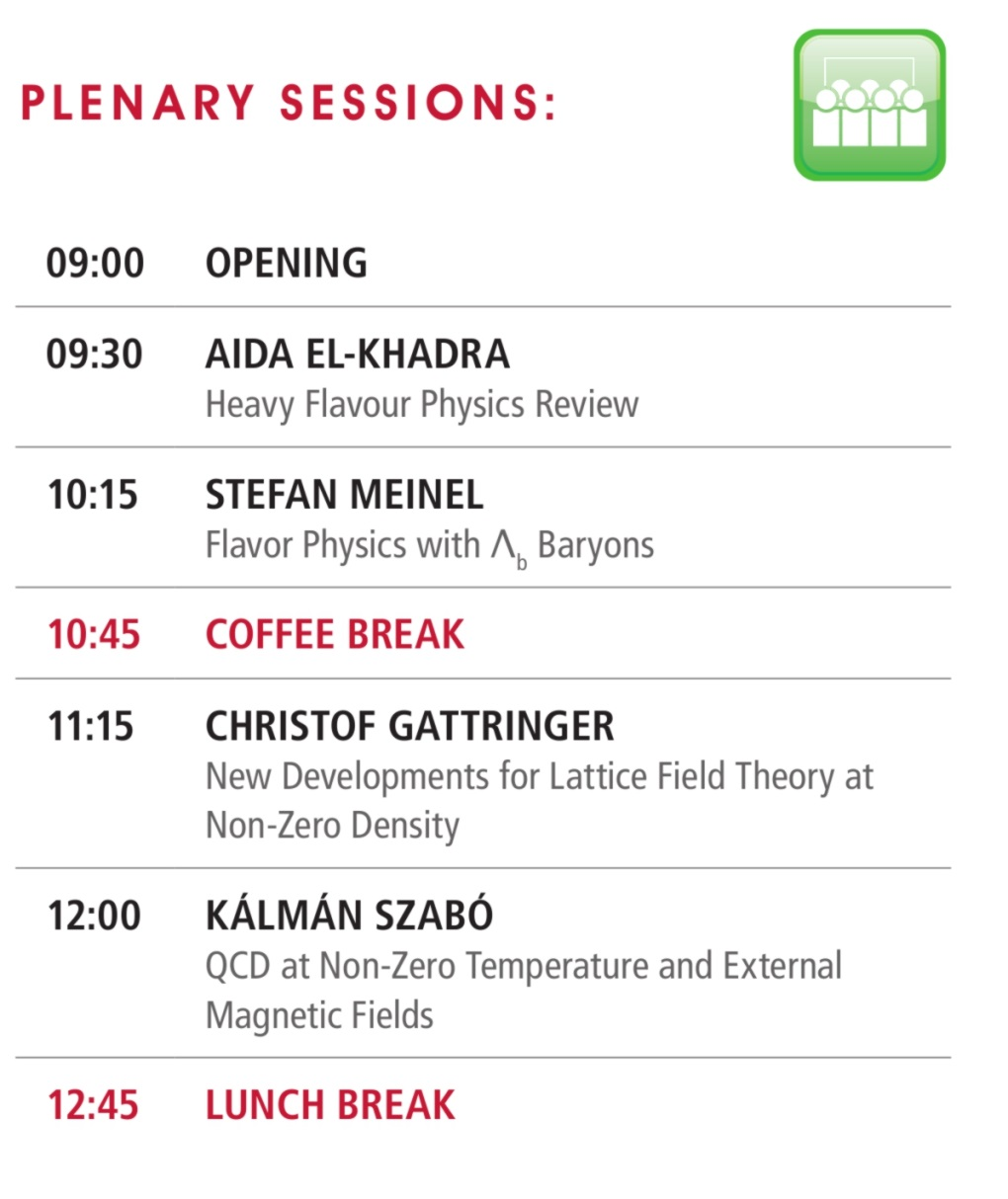
TexPoint fonts used in EMF.
Read the TexPoint manual before you delete this box.: AAAAAAAAAAAAAAAA

