Slide 1
Hosotani mechanism on the lattice
Guido Cossu
高エネルギ加速器研究機構
Lattice 2013
2013.8.2

Slide 2
Summary
Introduction
EW symmetry breaking mechanisms
Hosotani mechanism
The perturbative way
The lattice way
Related work (G.C., D’Elia)
Current work in collaboration with E. Itou (KEK), J. Noaki (KEK), Y. Hosotani (Osaka U.), H. Hatanaka (KIAS)
paper in preparation

Slide 3
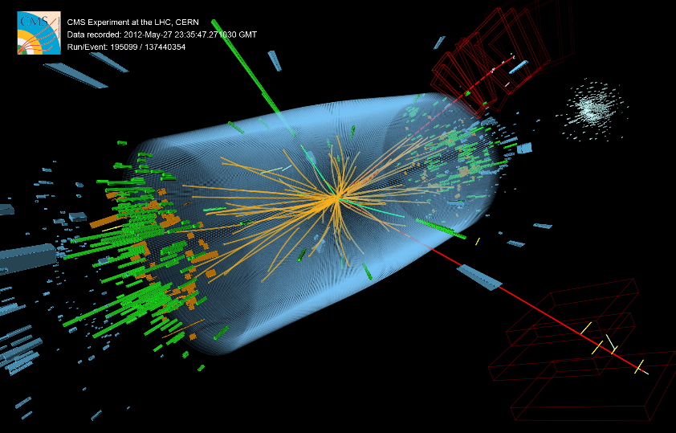
Breaking the symmetry
A mechanism that breaks the original symmetry is the backbone of the unification of gauge forces
Higgs mechanism
Dynamics?
(E)Technicolor
Extra-dimensions
Dimensional reduction
Layered phases
Orbifold BC
Hosotani mechanism
All physics can be described using gauge invariant quantities (e.g. the Higgs condensate) with no reference to the Higgs field v.e.v.
These quantities acquire a non zero v.e.v. and distinguish between the phases (as other observables).
Although gauge symmetry is never broken we can talk of gauge symmetry breaking in this sense.
CMS
Notes:
At least SSB of gauge symmetry must be clarified in its meaning

Slide 4
Hosotani mechanism
Hosotani, Phys. Lett. 126B,5(1983)309, Ann. Phys. 190(1989)233
A mechanism for dynamical mass generation by compact extra dimensions
Few results in summary (then details):
The ordinary vacuum is destabilized by the fermions obeying general boundary conditions
The gauge fields acquire masses
The fields in the compact dimension become “Higgs” scalar fields in the adjoint representation
The instability of the ordinary vacuum is independent of the dimensionality
Extensions for realistic models: orbifold (chiral fermions),
GUT theories on Randall-Sundrum spaces.

Slide 5
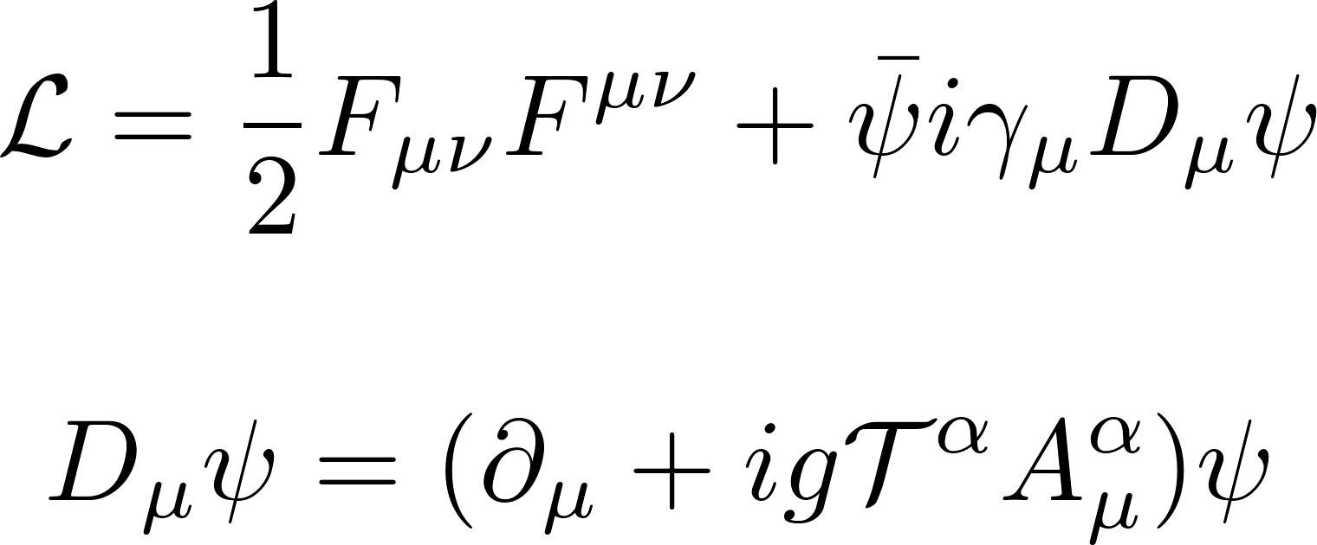
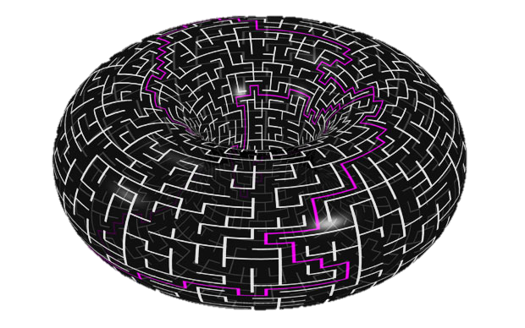
The perturbative way
Let’s simplify the discussion and concentrate on a torus topology with
where $L$ is the dimension of the warped direction
Homogeneous boundary conditions
Periodic boundary conditions
Anti-periodic boundary conditions (finite temperature)
defined on a manifold $M_{0}$, a multiply connected space
$M_{0}$ admits non-contractible paths
To fix the ideas let’s assume
Boundary conditions respect homogeneity of space
where $h_{a}(x)$ generates translation along one of the paths and $T_{a}$ a generator of the $SU(N)$ group

Slide 6
The perturbative way
Given the boundary conditions there is a residual gauge invariance if we require that U=I is preserved
In the simplest case this is guaranteed provided:
Not every vacuum is equivalent in this context.
Consider the fields with
The space of moduli (i.e. space of A with F=0 modulo gauge equivalence) is classified by the constant fields (Batakis, Lazarides 1978)
In general cannot be completely gauged away without changing the b.c.
Once the boundary cond. are given the are determined by the dynamics.
Notes:
Elitzur theorem: In a gauge invariant theory a local quantity with vanishing mean value on its orbit under the action of the gauge group has zero ground state expectation value.

Slide 7
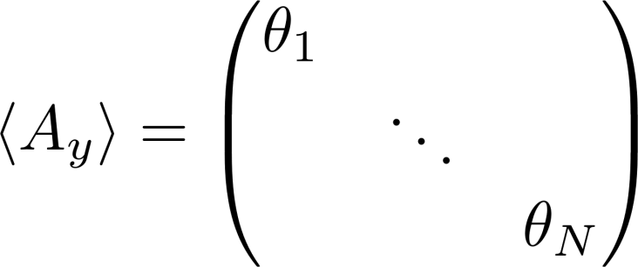
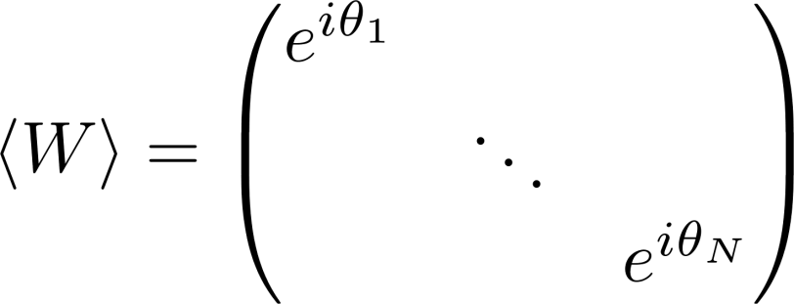
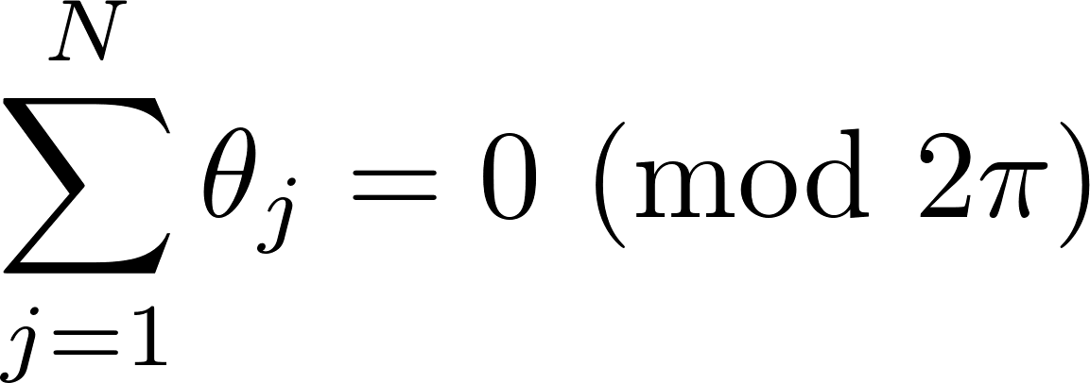
The perturbative way
After a gauge fix we can reduce to one of the non trivial and constant representatives of the gauge field (Batakis, Lazarides 1978)
These are like the Aharonov-Bohm phases in quantum electrodynamics
Dynamical degrees of freedom
In general these eigenmodes cannot be gauged away
Consider the non-integrable phase along the non contractible path C in the compact dimension:
It is gauge invariant and its eigenmodes are
Notes:
These representatives are the zero modes of the A_y assuming boundary conditions. Other modes can be gauged into this.

Slide 8
The perturbative way
The values of $θ_{j}$ are determined by the dynamics.
The vacuum is the minimum of the effective potential $V_{\text{eff}}(θ)$
At tree level the potential is zero, the vacuum is not changed.
At one loop we get the following results (massless fermions):
With massive fermions Bessel functions appear
Notes:
Vacuum trivial if only pure gauge, images of vacua from the article

Slide 9
Classification of phases
From perturbation theory we can show that in the new vacuum the $A_{y}$ field becomes a scalar field in the adjoint representation (Higgs-like)
Expanding in Fourier series the other components of the gauge field
The mass spectrum becomes
SU(3) asymmetric unless θ_{i} are all identical

Slide 10
Perturbative predictions
SU(3) gauge theory + massless fundamental fermions
Periodic b.c.
Symmetry SU(3)
Anti-periodic b.c. (finite temperature)
Symmetry SU(3)

Slide 11
Perturbative predictions
SU(3) gauge theory + massless adjoint fermions
Periodic b.c.
Symmetry U(1) ⊗ U(1)
Anti-periodic b.c. (finite temperature)
Symmetry SU(3)

Slide 12
Perturbative predictions
SU(3) gauge theory + massive adjoint fermions
varying mass and length of the compact dimension
Periodic b.c.
Symmetry U(1) ⊗ U(1)
Periodic b.c.
Symmetry SU(2) ⊗ U(1)
Periodic b.c.
Symmetry SU(3)

Slide 13
Lattice simulations
Expectations for the Polyakov Loop
 | $$(θ_{1},θ_{2},θ_{3})$$ | $$\left\langle P_{3}\right\rangle$$ | Symmetry
X | fluctuate | 0 | SU(3)
A | $$\left(0,0,0 \right),$$ $$(±\frac{2}{3}π,±\frac{2}{3}π,±\frac{2}{3}π)$$ | 1,$e^{±2πi/3}$ | SU(3)
B | $$\left(0,π,π \right),$$ $$(±\frac{1}{3}π,±\frac{1}{3}π,∓\frac{2}{3}π)$$ | $−\frac{1}{3}$,$\frac{1}{3}e^{±iπ/3}$ | SU(2)⊗U(1)
C | $$\left(0,\frac{2}{3}π,−\frac{2}{3}π \right)$$ | 0 | U(1)⊗U(1)

Slide 14
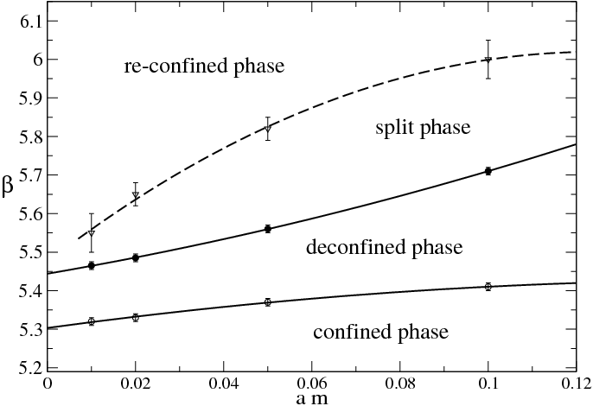
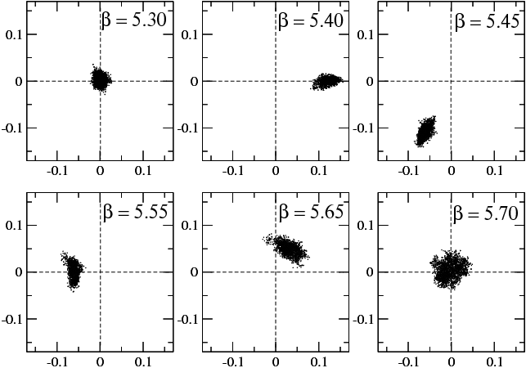
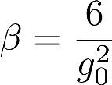
Literature
G.C. and M. D’Elia JHEP 0907, 048 (2009)
“Finite size transitions in QCD with adjoint fermions”
Shrinking S¹
Article phase names
Confined
Deconfined
Split
Re-confined
am=0.02, lattice 16³ x 4

Slide 15
The lattice way
Proof of concept
Point out the connection between the phases in $ℝ^{1,d−2}⨂𝕊^{1}$ lattice gauge theories with fermionic content and the Hosotani mechanism (every $d>2$ is fine)
Expand the phase diagram for adjoint fermions
Introduce more general phases as boundary conditions for fundamental fermions
C++ platform independent code for JLQCD collaboration
Running on BG/Q and SR16K (KEK, YITP)
http://suchix.kek.jp/guido_cossu/documents/DoxyGen/html/index.html
+ legacy code by H. Matsufuru

Slide 16
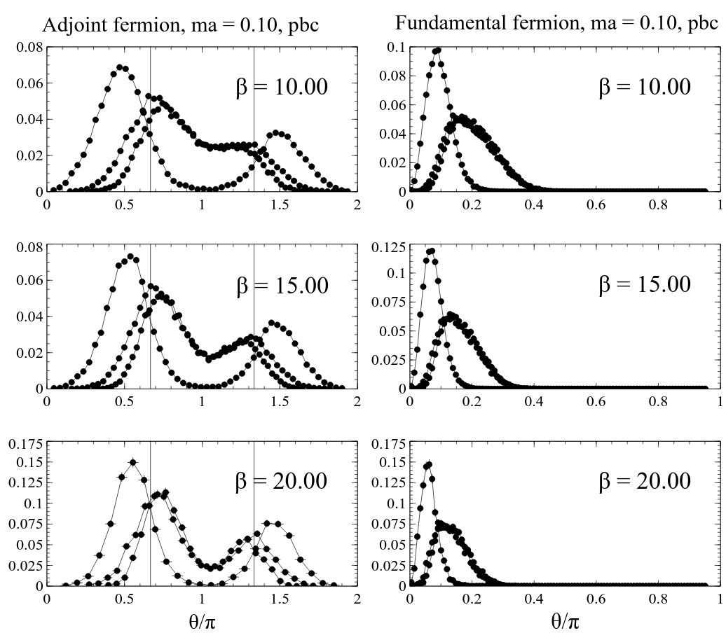
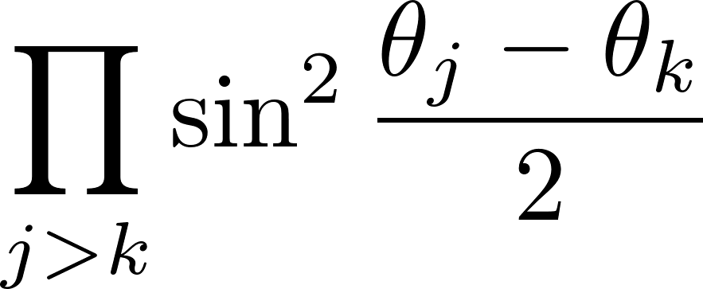
Polyakov loop eigenmodes
Perturbative limit of Δθ_{i}
Never degenerate because of the Haar measure for SU(3)
Weak coupling

Slide 17
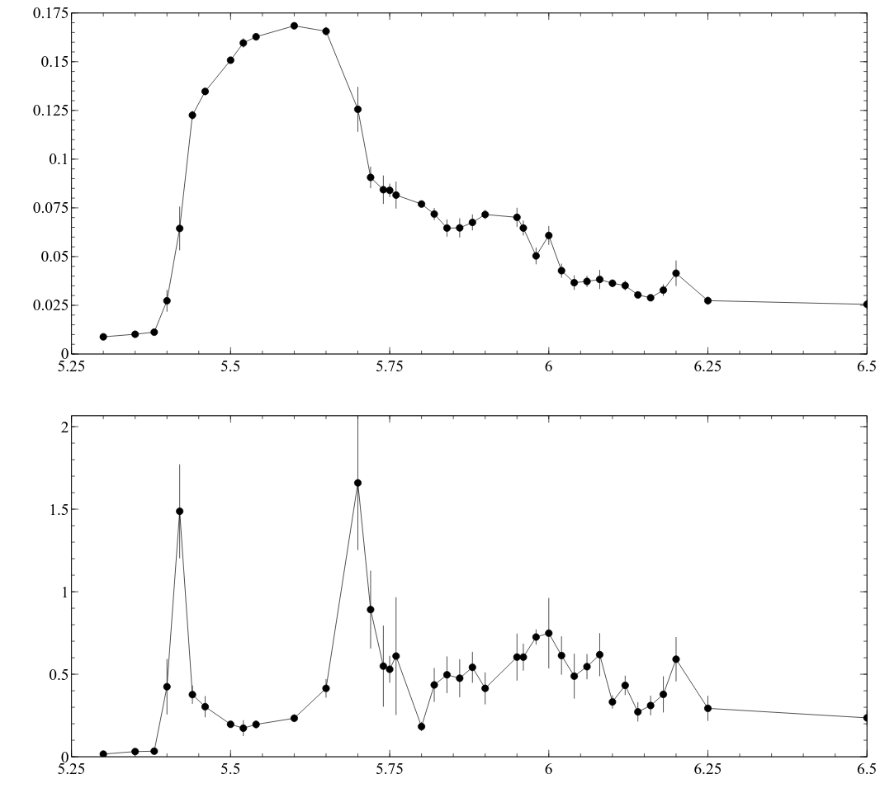
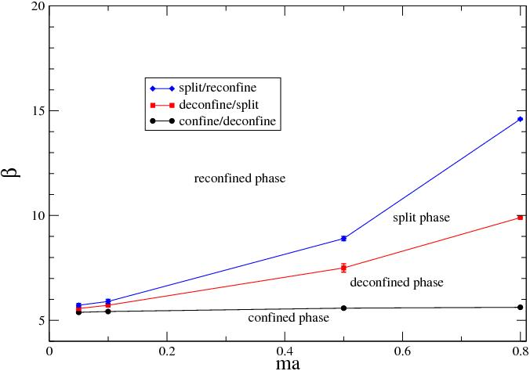
Phase diagram
Preliminary
16³x4 ,ma=0.1, N_{ad}=2

Slide 18
Fundamental fermions
Non trivial compactification with phase α
This is formally equivalent to adding an imaginary chemical potential.
Lot of previous works (De Forcrand, Philipsen – D’Elia, Lombardo, …)
Phase transition from chiral condensate
We concentrate on the Polyakov loop susceptibility
No “symmetry breaking” but non trivial phase space
Useful for future extension to mixed fermion content

Slide 19
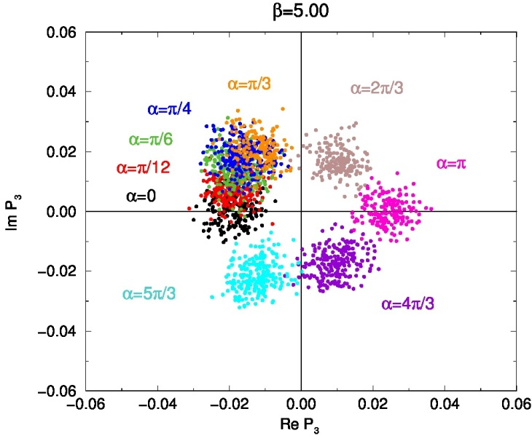
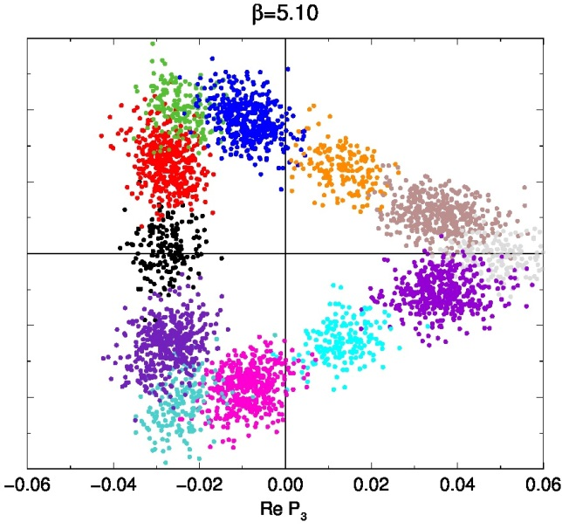
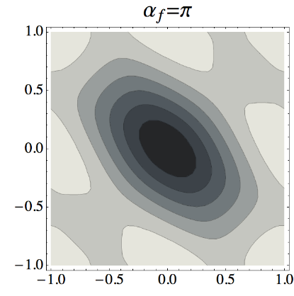
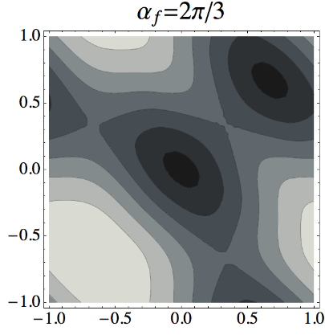
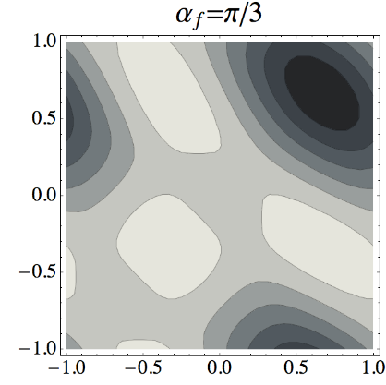
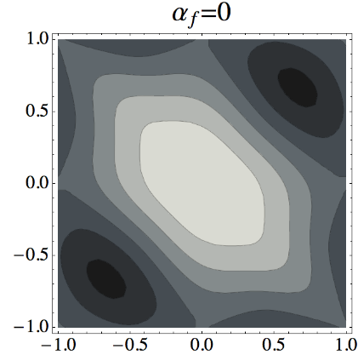
Preliminary results
Perturbative effective potential:

Slide 20
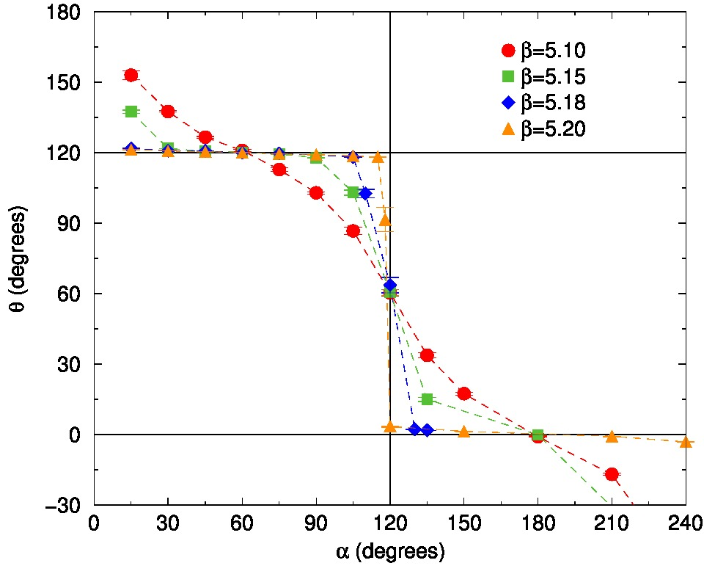
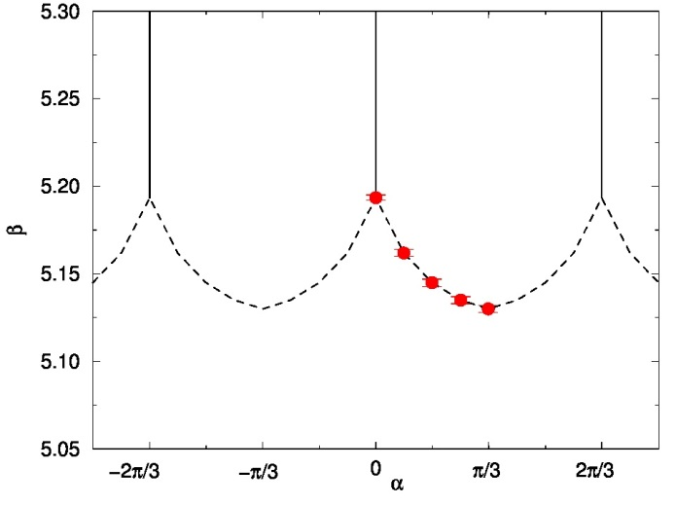
Approaching the transition point
Roberge-Weiss phase boundaries.
So far so good…

Slide 21
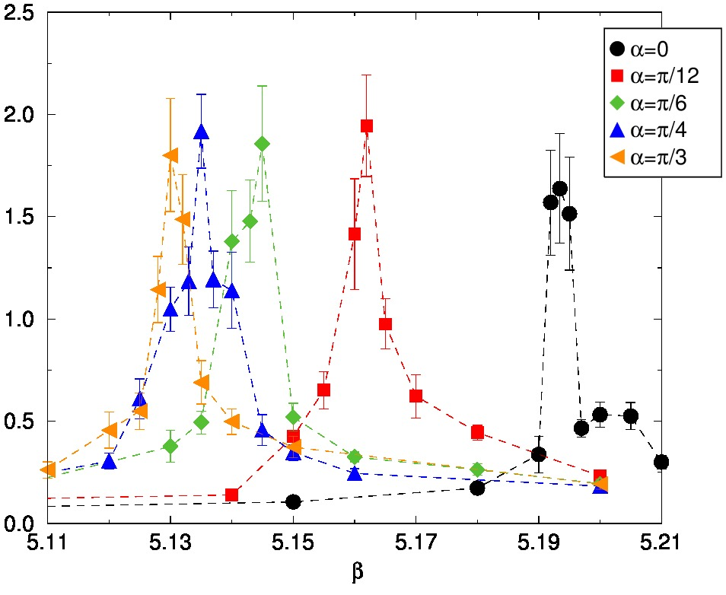
The phase space
Roberge-Weiss phase boundaries.

Slide 22
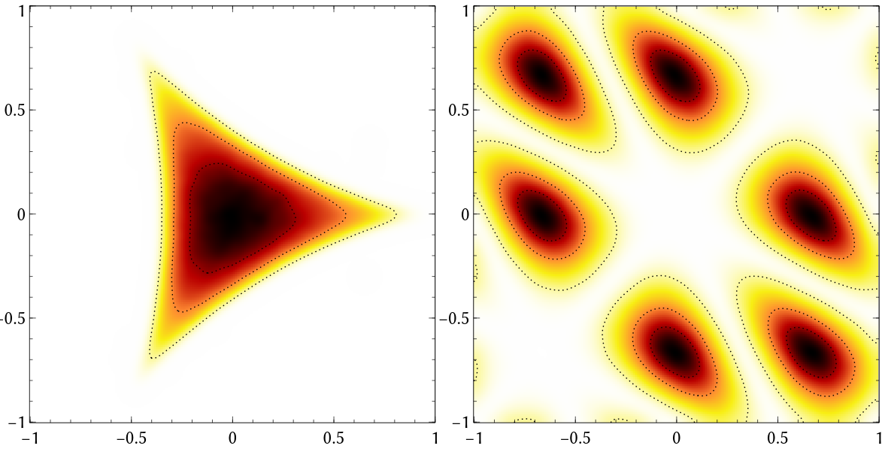
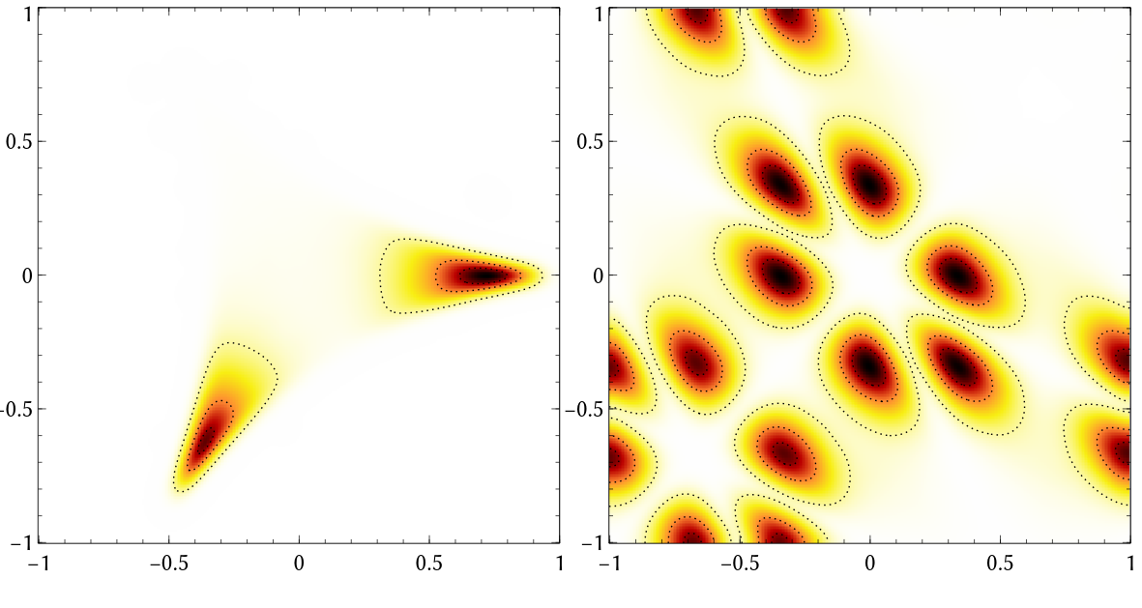
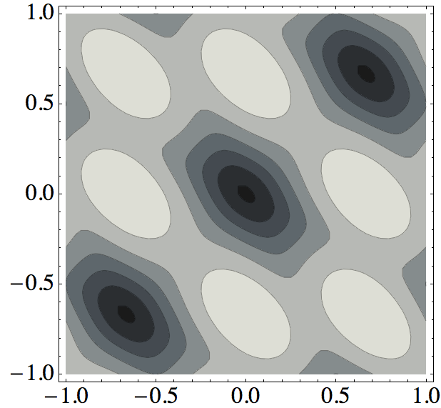
Adjoint case: PL eigenvalues
Density plots of Polyakov Loop and eigenvalues (phases)
No perturbative prediction
Strong fluctuations
Confined phase
Deconfined phase
SU(3)
Smearing applied. Haar measure term forbids equal phases

Slide 23
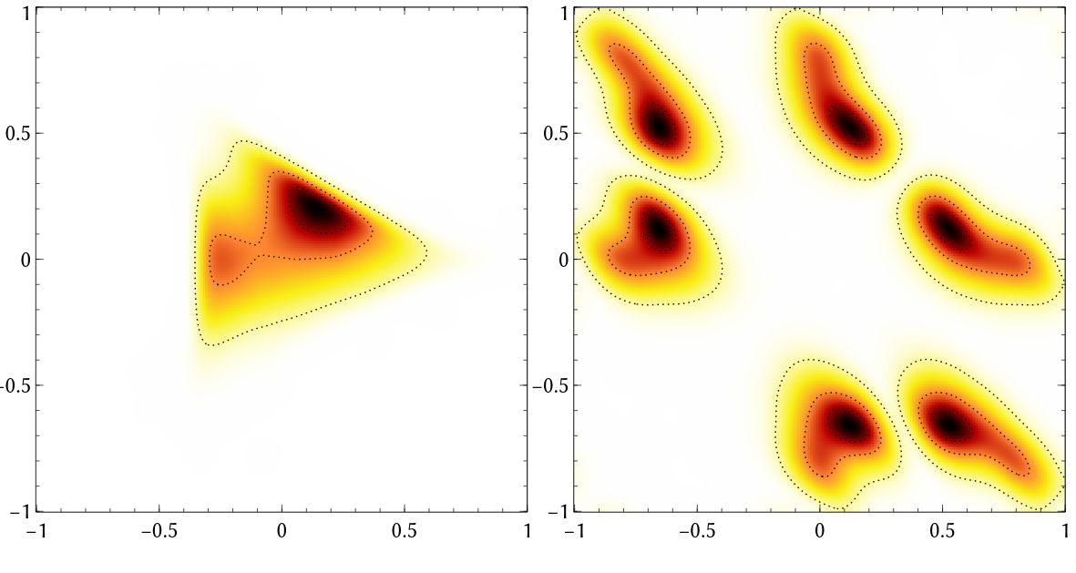
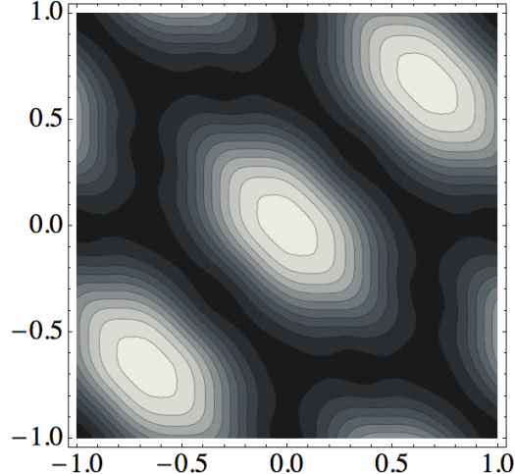
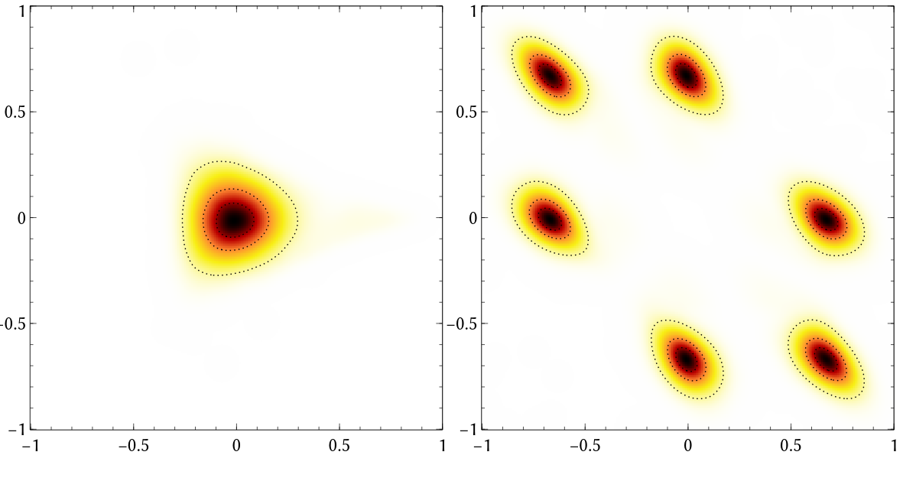
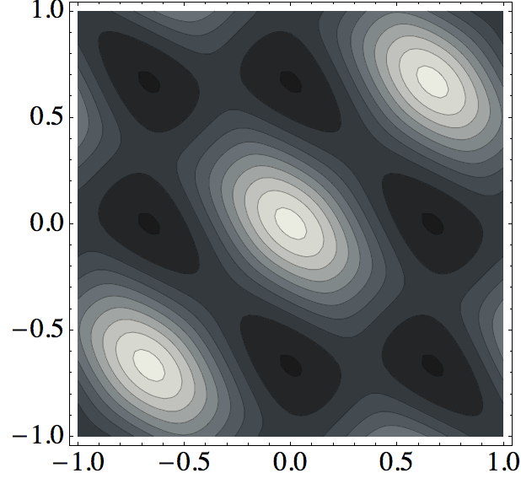
Polyakov Loop eigenvalues
Density plots of Polyakov Loop and eigenvalues (phases)
Split phase
SU(2) x U(1)
Reconfined phase
U(1) x U(1)

Slide 24
Plans
Still early stages, lot of things to study
Measure low modes masses
Continuum limit of the phase diagram
Study of the 4+1 dimensional case
Fermion formulation problematic(?)
Breaking pattern is different
Orbifolding
Detection of Kaluza-Klein modes

