Slide 1
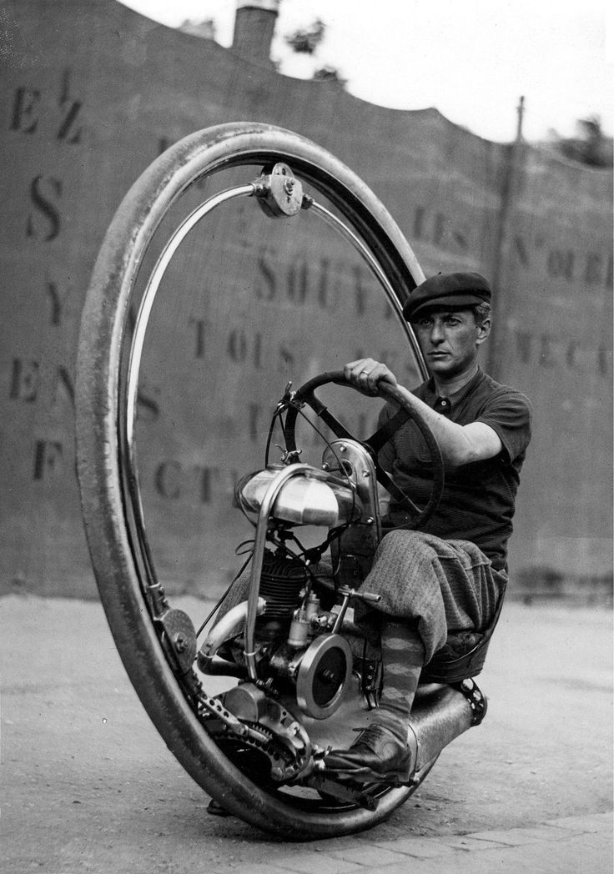
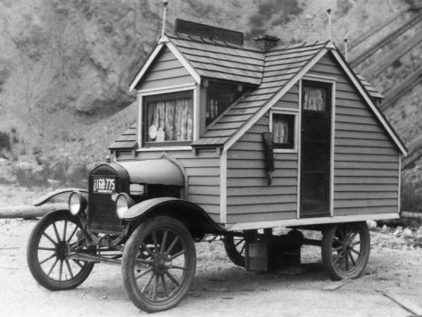
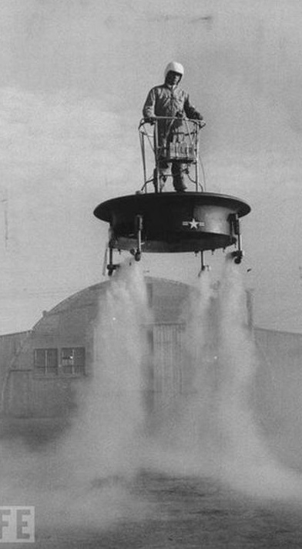
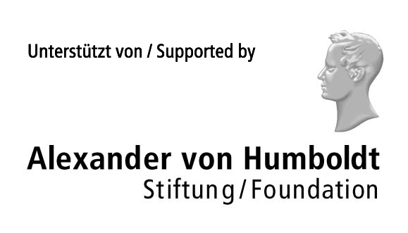
Towards lattice studies of Anomalous transport
Pavel Buividovich
(Regensburg)

Slide 2
To the memory of my Teacher,
excellent Scientist,
very nice and outstanding Person,
Prof. Dr. Mikhail Igorevich Polikarpov

Slide 3
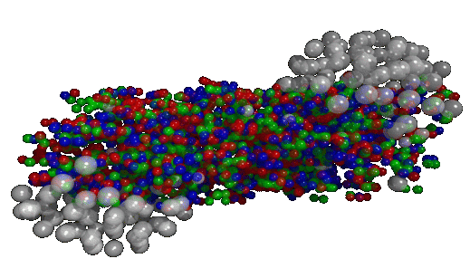
“New” hydrodynamics for HIC
Before 2008: classical hydro = conservation laws
shear/bulk viscosity
heat conductivity
conductivity
…
Essentially classical picture!!!
Quantum effects in hydrodynamics? YES!!!
In massless case – new (classical) integral of motion: chirality
“Anomalous” terms in hydrodynamical equations:
macroscopic memory of quantum effects
[Son, Surowka, ArXiv:0906.5044]
Integrate out free massless fermion gas
in arbitrary gauge background.
Very strange gas – can only expand with a speed of light!!!

Slide 4
“New” hydrodynamics: anomalous transport
Positivity of entropy production
uniquely fixes
“magnetic conductivities”!!!
Insert new equations into some hydro code
P-violating initial conditions (rotation, B field)
Experimental consequences?

Slide 5
Anomalous transport: CME, CSE, CVE
Chiral Magnetic Effect
[Kharzeev, Warringa,
Fukushima]
Chiral Separation Effect
[Son, Zhitnitsky]
Chiral Vortical Effect
[Erdmenger et al.,
Banerjee et al.]
Lorenz force Coriolis force (Rotating frame)

Slide 6
T-invariance and absence of dissipation
Dissipative transport
(conductivity, viscosity)
No ground state
T-noninvariant (but CP)
Spectral function = anti-Hermitean part of retarded correlator
Work is performed
Dissipation of energy
First k → 0, then w → 0
Anomalous transport
(CME, CSE, CVE)
Ground state
T-invariant (but not CP!!!)
Spectral function = Hermitean part of retarded correlator
No work is performed
No dissipation of energy
First w → 0, then k → 0

Slide 7
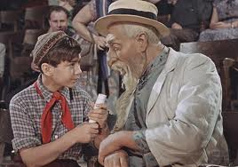
Anomalous transport: CME, CSE, CVE
Folklore on CME & CSE:
Transport coefficients are RELATED to anomaly
and thus protected from:
perturbative corrections
IR effects (mass etc.)
Check these statements as applied to the lattice
What is measurable? How should one measure?
CVE coefficient is not fixed
Phenomenologically important!!! Lattice can help

Slide 8
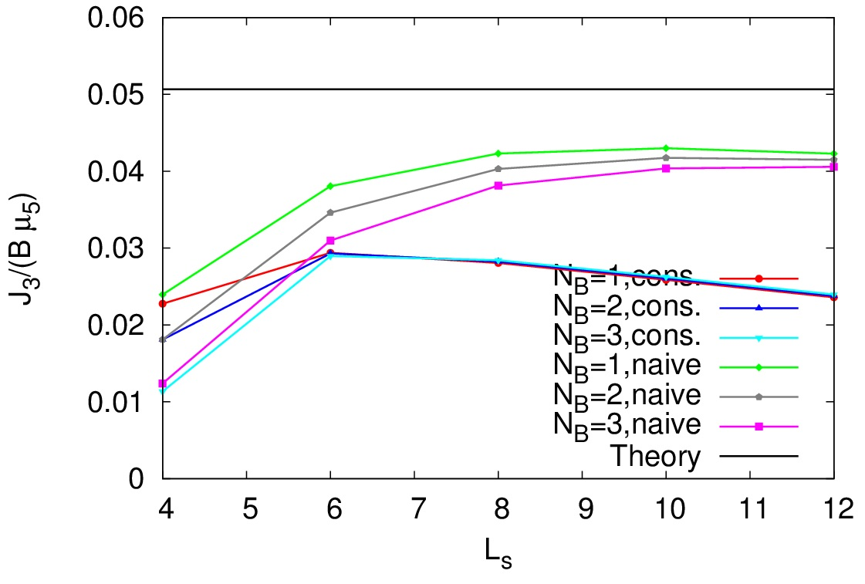
CME with overlap fermions
ρ = 1.0, m = 0.05

Slide 9
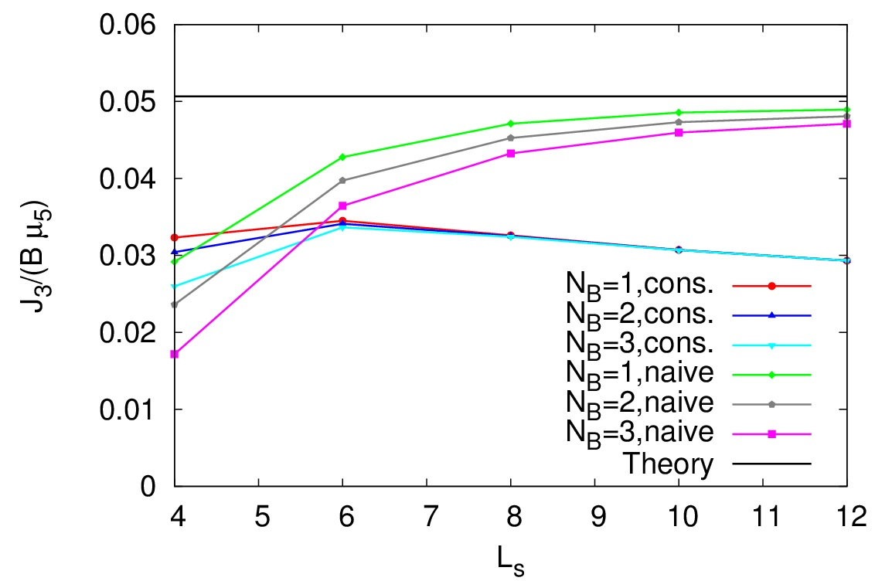
CME with overlap fermions
ρ = 1.4, m = 0.01

Slide 10
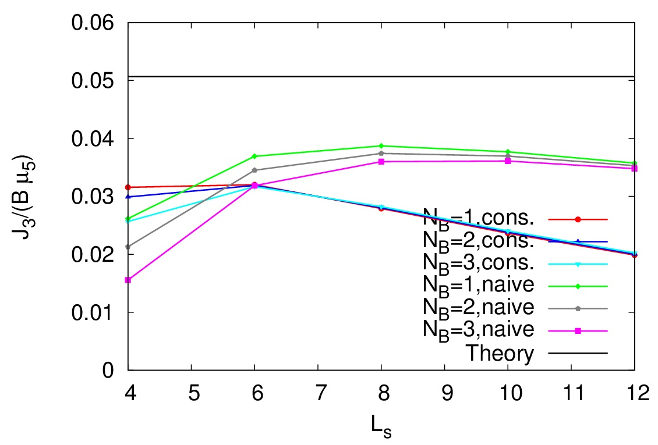
CME with overlap fermions
ρ = 1.4, m = 0.05

Slide 11
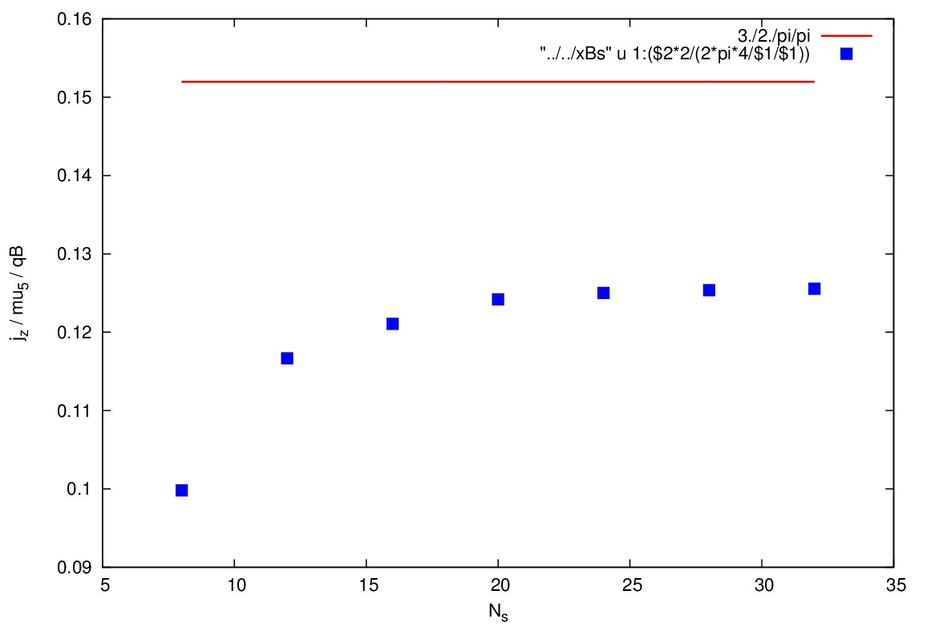
Staggered fermions [G. Endrodi]
Bulk definition of μ₅ !!! Around 20% deviation

Slide 12
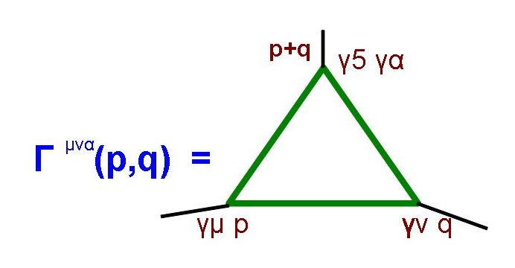
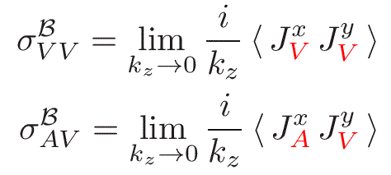
Relation of CME to anomaly
Flow of a massless fermion gas in a classical gauge
field and chiral chemical potential
In terms of correlators:

Slide 13
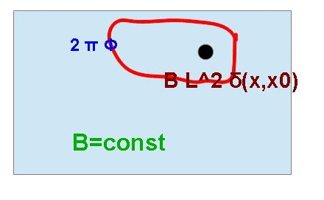
CME: “Background field” method
CLAIM: constant magnetic field in finite volume
is NOT a small perturbation
“triangle diagram” argument invalid
(Flux is quantized, 0 → 1 is not a perturbation, just like an instanton number)
More advanced argument:
in a finite volume
Solution: hide extra flux in the delta-function
Fermions don’t note this singularity if
Flux quantization!

Slide 14
Closer look at CME: analytics
Partition function of Dirac fermions in a finite Euclidean box
Anti-periodic BC in time direction, periodic BC in spatial directions
Gauge field A₃=θ – source for the current
Magnetic field in XY plane
Chiral chemical potential μ₅ in the bulk
Dirac operator:

Slide 15
Closer look at CME: analytics
Creation/annihilation operators in magnetic field:
Now go to the Landau-level basis:
Higher Landau levels
(topological)
zero modes

Slide 16
Closer look at CME: LLL dominance
Dirac operator in the basis of LLL states:
Vector current:
Prefactor comes from LL degeneracy
Only LLL contribution is nonzero!!!

Slide 17
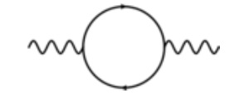
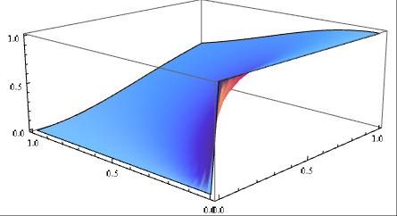
Dimensional reduction: 2D axial anomaly
Polarization tensor in 2D:
Proper regularization (vector current conserved):
[Chen,hep-th/9902199]
Final answer:
Value at k₀=0, k₃=0: NOT DEFINED
(without IR regulator)
First k₃ → 0, then k₀ → 0
Otherwise zero

Slide 18
CME, CSE and axial anomaly
Most general decomposition for VVA correlator
[M. Knecht et al., hep-ph/0311100]:
Axial anomaly: w_{L}(q₁², q₂², (q₁+q₂)²)
CME (q₁ = -q₂ = q): w_{T}⁽⁺⁾ (q², q², 0)
CSE (q₁=q, q₂ = 0): IDENTICALLY ZERO!!!

Slide 19
CME and axial anomaly (continued)
In addition to anomaly non-renormalization,
new (perturbative!!!) non-renormalization theorems
[M. Knecht et al., hep-ph/0311100]
[A. Vainstein, hep-ph/0212231]:
Valid only for massless QCD!!!

Slide 20
CME and axial anomaly (continued)
From these relations one can show
And thus CME coefficient is fixed:
In terms of correlators:
Naively, one can also use
Simplifies lattice measurements!!!

Slide 21
CME and axial anomaly (continued)
CME is related to anomaly (at least) perturbatively in massless QCD
Probably not the case at nonzero mass
Nonperturbative contributions could be important (confinement phase)?
Interesting to test on the lattice
Relation valid in linear response approximation
Hydrodynamics!!!

Slide 22
Dirac operator with axial gauge fields
First consider coupling to axial gauge field:
Assume local invariance under
modified chiral transformations
[Kikukawa, Yamada, hep-lat/9808026]:
Require
(Integrable) equation for D_{ov} !!!

Slide 23
Dirac operator with chiral chemical potential
In terms of or
Solution is very similar to continuum:
Finally, Dirac operator with chiral chemical potential:

Slide 24
Conserved current for overlap
Generic expression for
the conserved current
Eigenvalues of D_{w} in practice never cross zero…

Slide 25
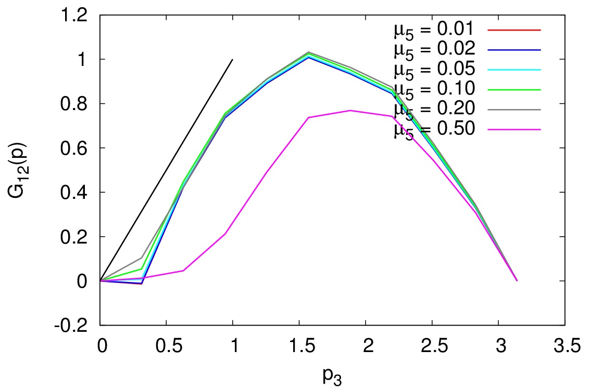
Three-point function with free overlap (conserved current, Ls = 20)
μ₅ is in Dirac-Wilson, still a correct coupling in the IR

Slide 26
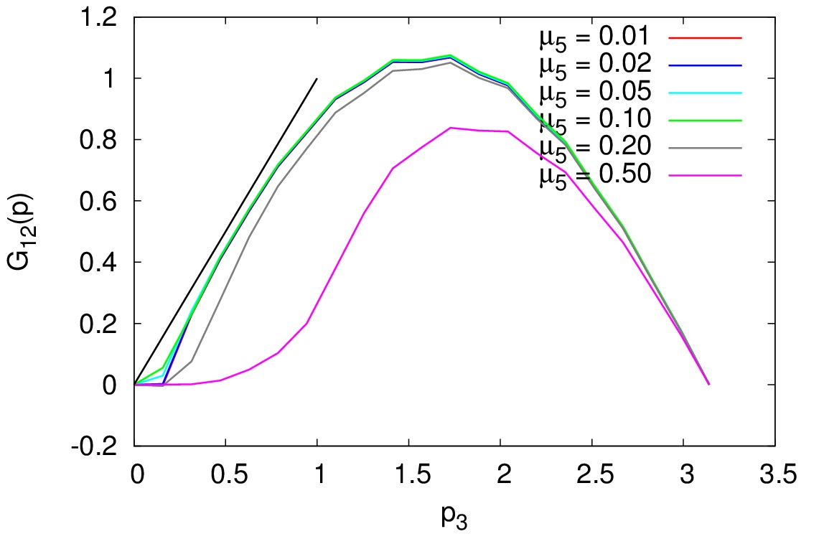
Three-point function with free overlap (conserved current, Ls = 40)
μ₅ is in Dirac-Wilson, still a correct coupling in the IR

Slide 27
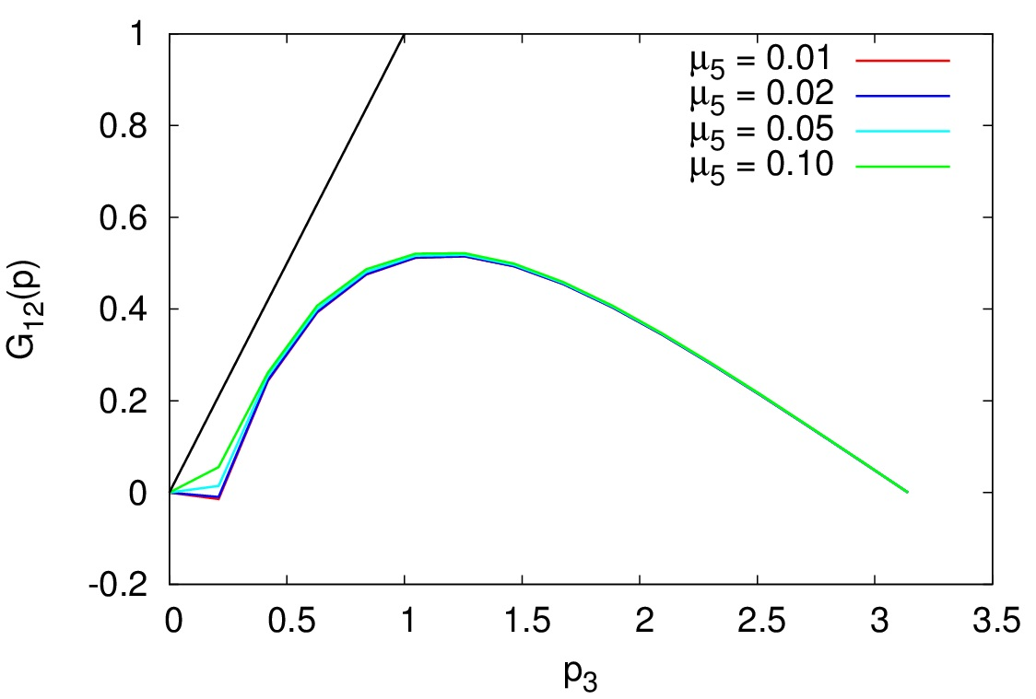
Three-point function with massless Wilson-Dirac (conserved current, Ls = 30)

Slide 28
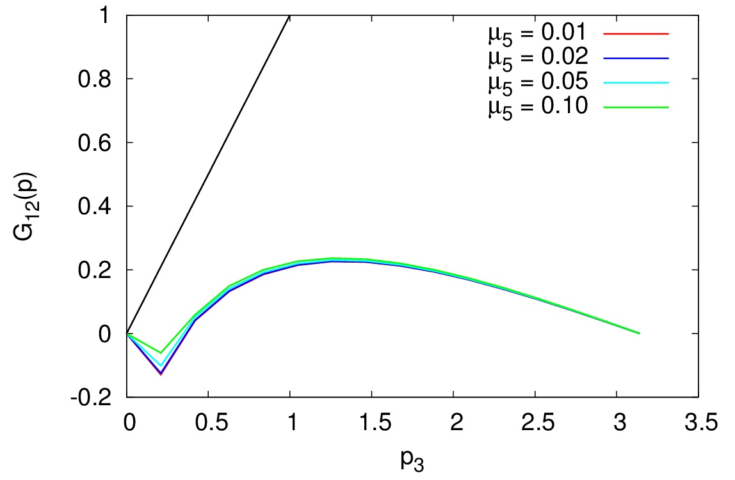
Three-point function with massless overlap (naive current, Ls = 30)
Conserved current is very important!!!

Slide 29
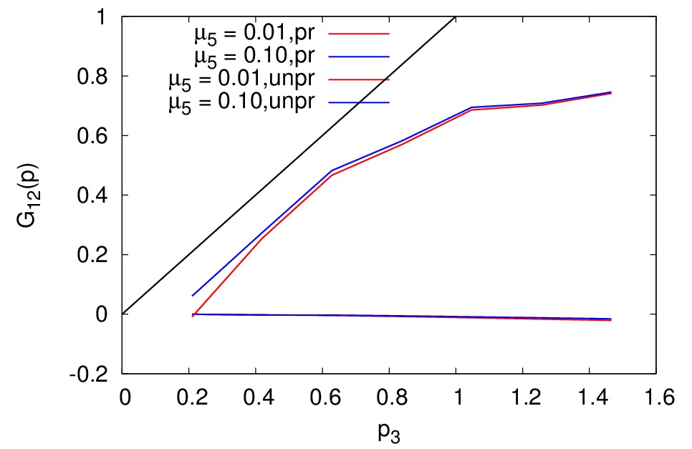
Projection back to GW circle
Only Dirac operator with spectrum on GW circle correctly reproduces the anomaly

Slide 30
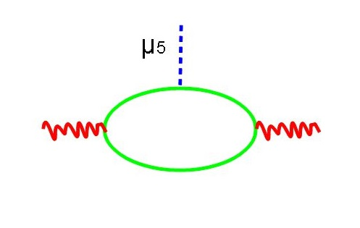
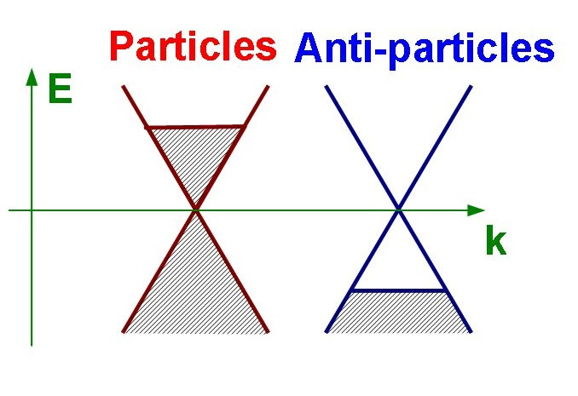
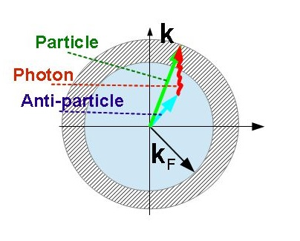
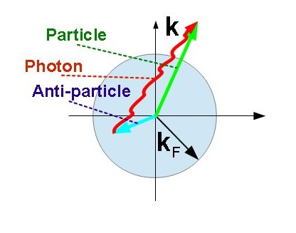
Fermi surface singularity Almost correct, but what is at small p₃???
Full phase space is available only at |p|>2|k_{F}|

Slide 31
Conclusions
Measure spatial correlators + Fourier transform
External magnetic field: limit k0 →0 required after k3 →0, analytic continuation???
External fields/chemical potential are not compatible with perturbative diagrammatics
Static field limit not well defined
Result depends on IR regulators

Slide 32
Backup slides

Slide 33
Chemical potential for anomalous charges
Chemical potential for conserved charge (e.g. Q):
Non-compact
gauge transform
In the action
Via boundary conditions
For anomalous charge:
General gauge transform
BUT the current is not conserved!!!
Topological charge density
Chern-Simons current

Slide 34
CME and CVE: lattice studies
Simplest method: introduce sources in the action
Constant magnetic field
Constant μ5 [Yamamoto, 1105.0385]
Constant axial magnetic field [ITEP Lattice, 1303.6266]
Rotating lattice??? [Yamamoto, 1303.6292]
“Advanced” method:
Measure spatial correlators
No analytic continuation necessary
Just Fourier transforms
BUT: More noise!!!
Conserved currents/
Energy-momentum tensor
not known for overlap

Slide 35
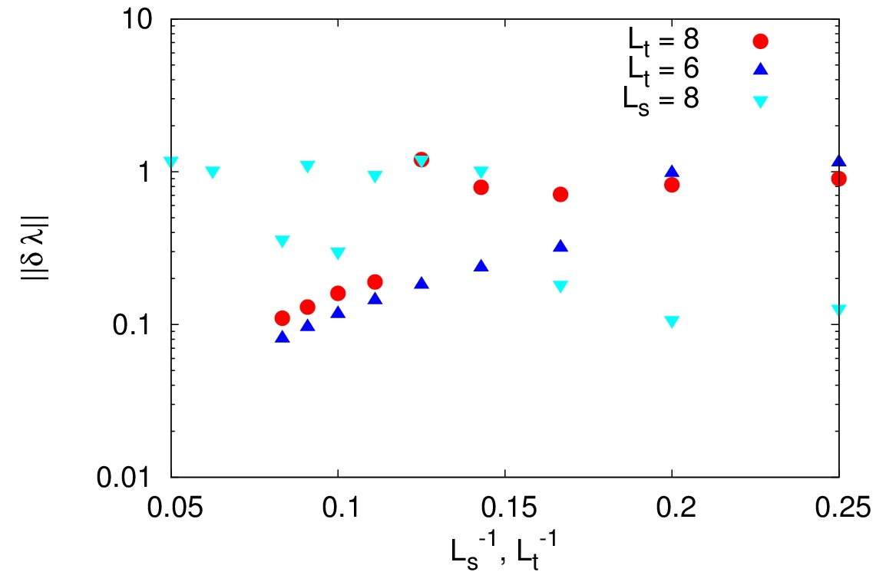
Dimensional reduction with overlap
First Lx,Ly →∞ at fixed Lz, Lt, Φ !!!

Slide 36
IR sensitivity: aspect ratio etc.
L3 →∞, Lt fixed: ZERO (full derivative)
Result depends on the ratio Lt/Lz

Slide 37
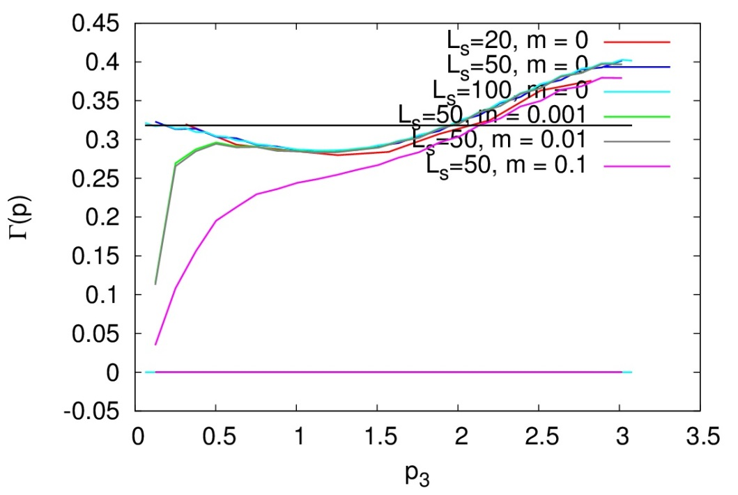
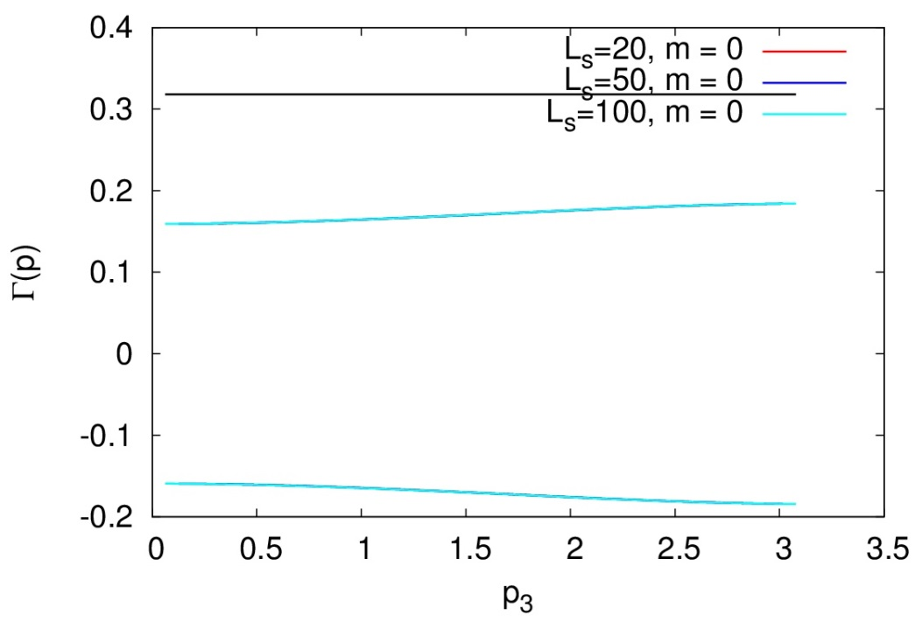
Importance of conserved current
2D axial anomaly:
Correct
polarization tensor:
Naive
polarization tensor:

Slide 38
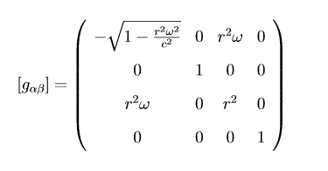
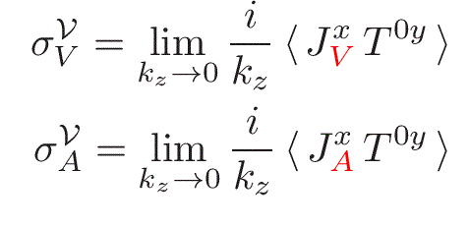
Chiral Vortical Effect
Linear response of currents to “slow” rotation:
In terms of correlators
Subject to
PT corrections!!!

Slide 39
Lattice studies of CVE
A naïve method [Yamamoto, 1303.6292]:
Analytic continuation of rotating frame metric
Lattice simulations with distorted lattice
Physical interpretation is unclear!!!
By virtue of Hopf theorem:
only vortex-anti-vortex pairs allowed on torus!!!
More advanced method
[Landsteiner, Chernodub & ITEP Lattice, ]:
Axial magnetic field = source for axial current
T_{0y} = Energy flow along axial m.f.
Measure energy flow in the background axial
magnetic field

Slide 40
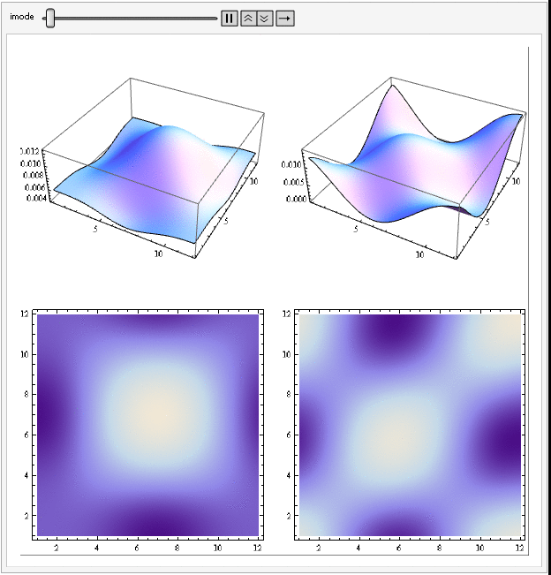
Dirac eigenmodes in axial magnetic field

Slide 41
Dirac eigenmodes in axial magnetic field
Landau levels for vector magnetic field:
Rotational symmetry
Flux-conserving singularity not visible
Dirac modes in axial magnetic field:
Rotational symmetry broken
Wave functions are localized on the boundary
(where gauge field is singular)
“Conservation of complexity”:
Constant axial magnetic field in finite volume
is pathological

Slide 42
Chirality n₅ vs μ₅
μ₅ is not a physical quantity, just Lagrange multiplier
Chirality n₅ is (in principle) observable
Express everything in terms of n₅
To linear order in μ₅ :
Singularities of Π₃₃ cancel !!!
Note: no non-renormalization for two loops or higher and no dimensional reduction due to 4D gluons!!!

