Slide 1
A direct relation between confinement and chiral symmetry breaking in temporally odd-number lattice QCD
Takahiro Doi (Kyoto University)
in collaboration with
Hideo Suganuma (Kyoto Univesity)
Takumi Iritani (KEK)
Abstract:
We derive an identity connecting Polyakov loop and Dirac modes in temporally
odd-number lattice, where the temporal length is odd in lattice unit.
This identity describes the relation between confinement and chiral symmetry breaking.
From this identity, we conclude that there is no one-to-one correspondence between
confinement and chiral symmetry breaking in QCD.
We have numerically confirmed this identity. Moreover, modifying Kogut-Susskind formalism for even lattice, we develop the method for spin-diagonalizing Dirac operator
in the temporally odd-number lattice.
Lattice 2013 July 29, 2013, Mainz

Slide 2
Contents
Introduction
Quark Confinement(Confinement)
Chiral Symmetry Breaking(CSB)
Previous Works
QCD phase transition at finite temperature
S. Gongyo, T. Iritani, H. Suganuma
Our Work
A Direct Relation between Polyakov loop and Dirac mode
in Temporally Odd Number Lattice
New Modified KS Formalism in Temporally Odd Number Lattice

Slide 3
Contents
Introduction
Quark Confinement(Confinement)
Chiral Symmetry Breaking(CSB)
Previous Works
QCD phase transition at finite temperature
S. Gongyo, T. Iritani, H. Suganuma
Our Work
A Direct Relation between Polyakov loop and Dirac mode
in Temporally Odd Number Lattice
New Modified KS Formalism in Temporally Odd Number Lattice

Slide 4
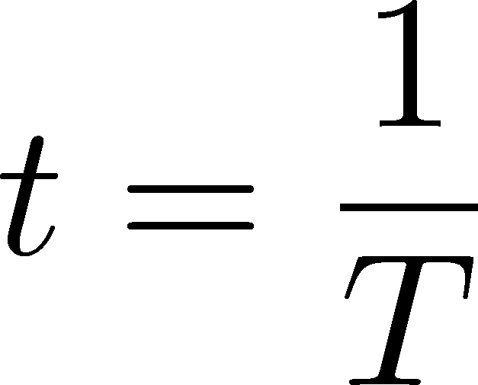
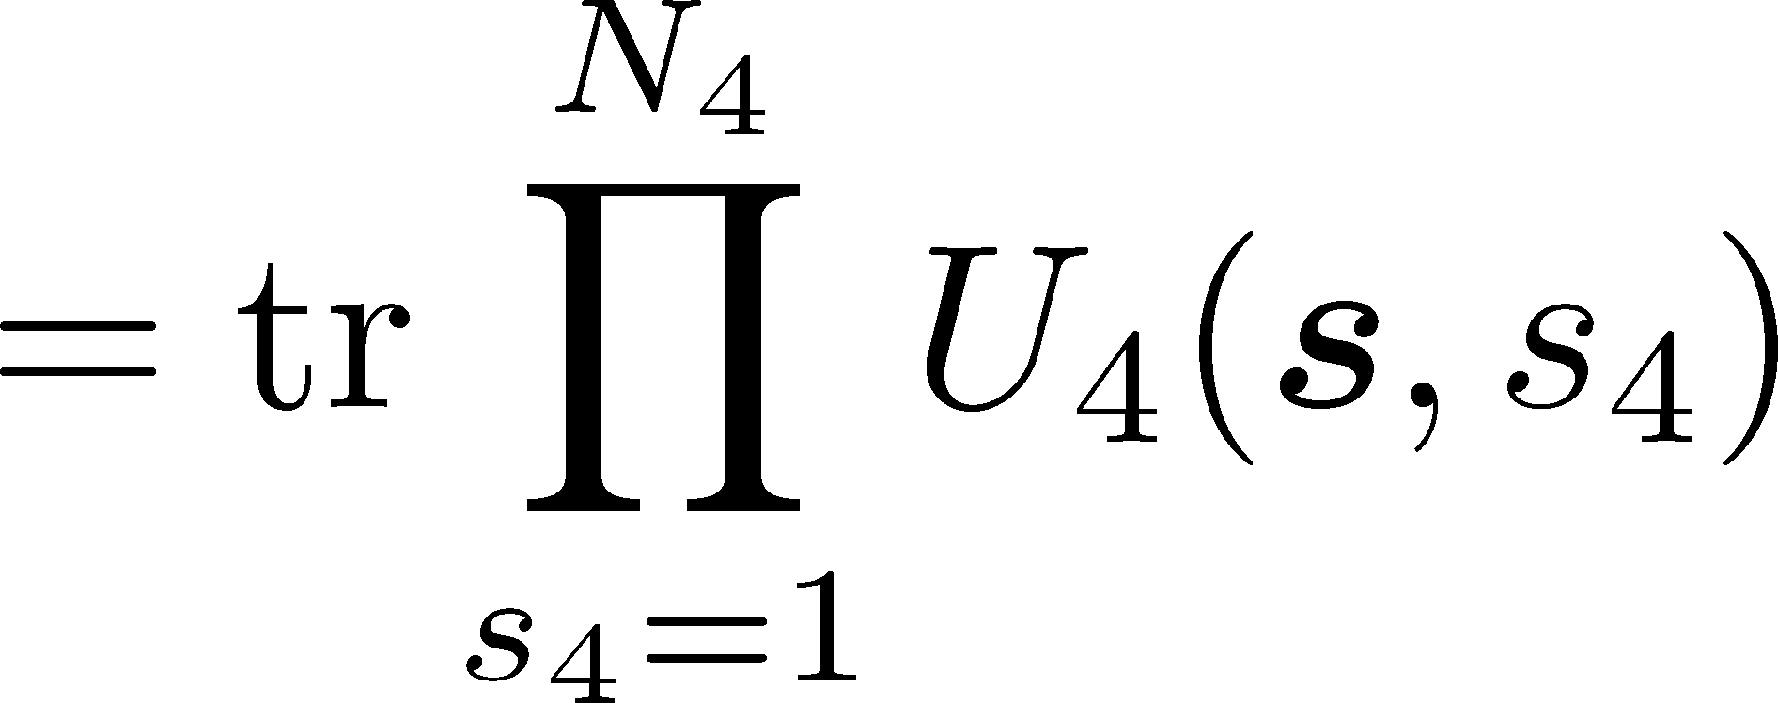
Introduction – Quark confinement
Confinement : one cannot observe colored state (one quark, gluons, ・・・)
one can observe only color-singlet states (mesons, baryons, ・・・)
Polyakov loop : order parameter for quark deconfinement phase transition
in quenched approximation.
4(t)
in continuum theory
in lattice theory
Finite temperature :
periodic boundary condition for time direction
:Polyakov loop
:free energy of the system
with a single heavy quark

Slide 5
Introduction – Chiral Symmetry Breaking
・Chiral symmetry breaking : chiral symmetry is spontaneously broken
CSB
for example
・ u, d quarks get dynamical mass(constituent mass)
・ Pions appear as NG bosons
・Chiral condensate : order parameter for chiral phase transition
・Banks-Casher relation
:Dirac eigenvalue density

Slide 6
Contents
Introduction
Quark Confinement(Confinement)
Chiral Symmetry Breaking(CSB)
Previous Works
QCD phase transition at finite temperature
S. Gongyo, T. Iritani, H. Suganuma
Our Work
A Direct Relation between Polyakov loop and Dirac mode
in Temporally Odd Number Lattice
New Modified KS Formalism in Temporally Odd Number Lattice

Slide 7
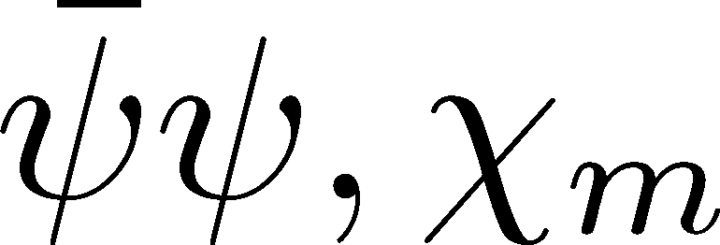
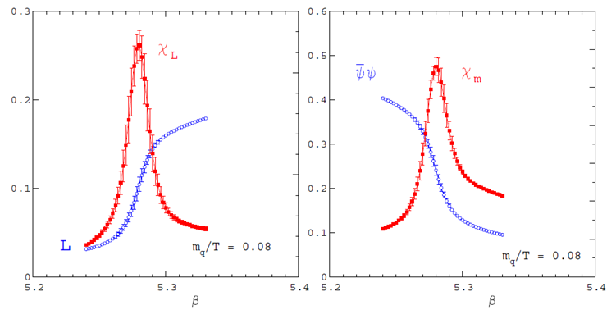
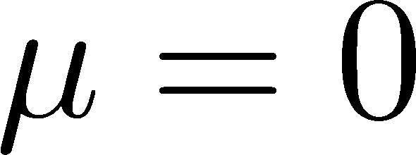
QCD phase transition at finite temperature
F. Karsch, Lect. Notes Phys. 583, 209 (2002)
:Polyakovloop and it’s susceptibility
:chiral condensate and it’s susceptibility
deconfinement transition
chiral transition
・
・ two flavor QCD
with light quarks
Low T
High T
Low T
High T

Slide 8
QCD phase transition at finite temperature
F. Karsch, Lect. Notes Phys. 583, 209 (2002)
:Polyakovloop and it’s susceptibility
:chiral condensate and it’s susceptibility
deconfinement transition
chiral transition
・
・ two flavor QCD
with light quarks
We define critical temperature
as the peak of susceptibility
Low T
High T
Low T
High T
These two phase transitions are strongly correlated(?)

Slide 9
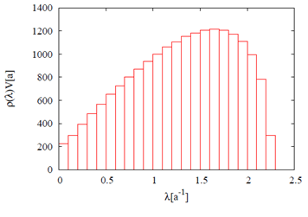
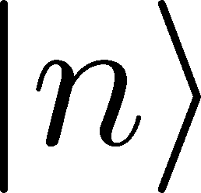
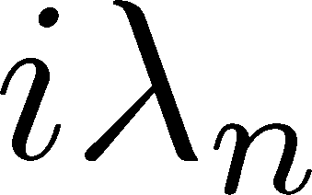
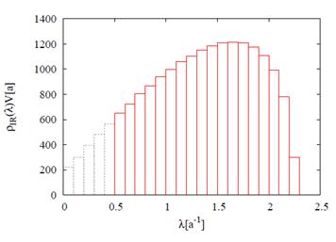
Confinement and Chiral Symmetry Breaking
S. Gongyo, T. Iritani, H. Suganuma, PRD86 (2012) 034510
Dirac eigenvalue equation:
Dirac eigenmode:
Dirac eigenvalue:
Dirac eigenvalue density:
Banks-Casher relation:
removing low-lying Dirac modes(Dirac IR cut)
removing the essence of CSB
※This formalism is manifestly gauge invariant.

Slide 10
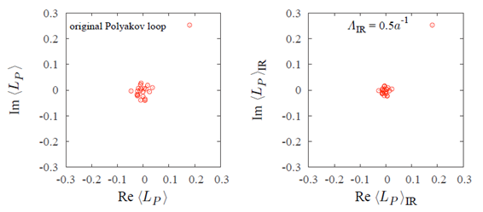
Confinement and Chiral Symmetry Breaking
S. Gongyo, T. Iritani, H. Suganuma, PRD86 (2012) 034510
:Polyakov loop
removing low-lying Dirac modes
After removing the essence of CSB, the confinement property is kept
one-to-one correspondence does not hold
for confinement and chiral symmetry breaking in QCD.

Slide 11
Contents
Introduction
Quark Confinement(Confinement)
Chiral Symmetry Breaking(CSB)
Previous Works
QCD phase transition at finite temperature
S. Gongyo, T. Iritani, H. Suganuma
Our Work
A Direct Relation between Polyakov loop and Dirac mode
in Temporally Odd Number Lattice
New Modified KS Formalism in Temporally Odd Number Lattice

Slide 12
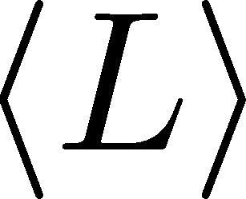
A Direct Relation between Polyakov loop and Dirac mode in Temporally Odd Number Lattice
H. Suganuma, T. Iritani, T. M. D.
(Previous presentation)
in temporally odd number lattice:
・・・(A)
Polyakov loop :
notation:
Dirac eigenmode :
Link variable operator :
・Dirac zero modes are important for CSB (Banks-Casher relation)
・Dirac zero modes have little contribution to Polyakov loop
The relation between Confinement and CSB is not one-to-one correspondence in QCD.
This conclusion agrees with the previous work by Gongyo, Iritani, Suganuma.

Slide 13
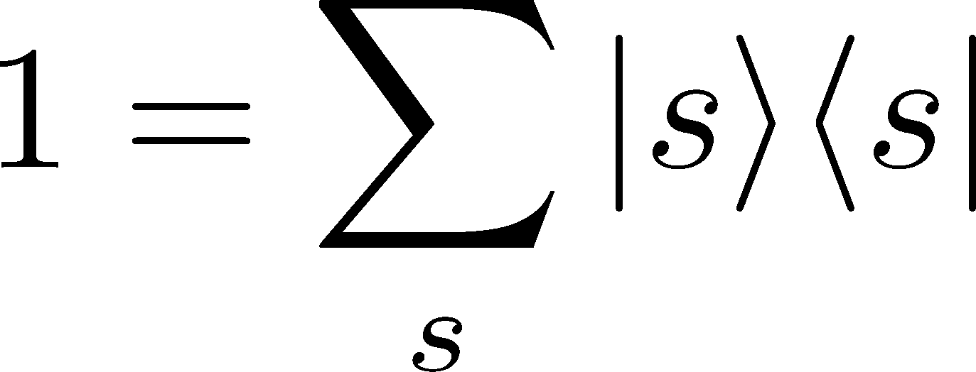
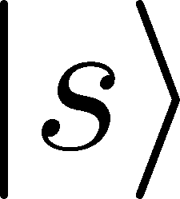
Numerical Confirmation of Analytical Relation (A)
Numerical confirmation of this relation is important.
notation and
coordinate representation
・・・(A)
: easily obtained
*This formalism is gauge invariant.
:are determined from
: site
explicit form of the Dirac eigenvalue equation
where

Slide 14
Kogut-Susskind (KS) Formalism
explicit form of the Dirac eigenvalue equation
where
In solving Dirac eigenvalue equation, to reduce the calculation without any approximation,
We want to use KS formalism.
However, In temporally odd number lattice, KS formalism is not available directly.
We developed new modified KS formalism applicable to temporally odd number lattice.

Slide 15
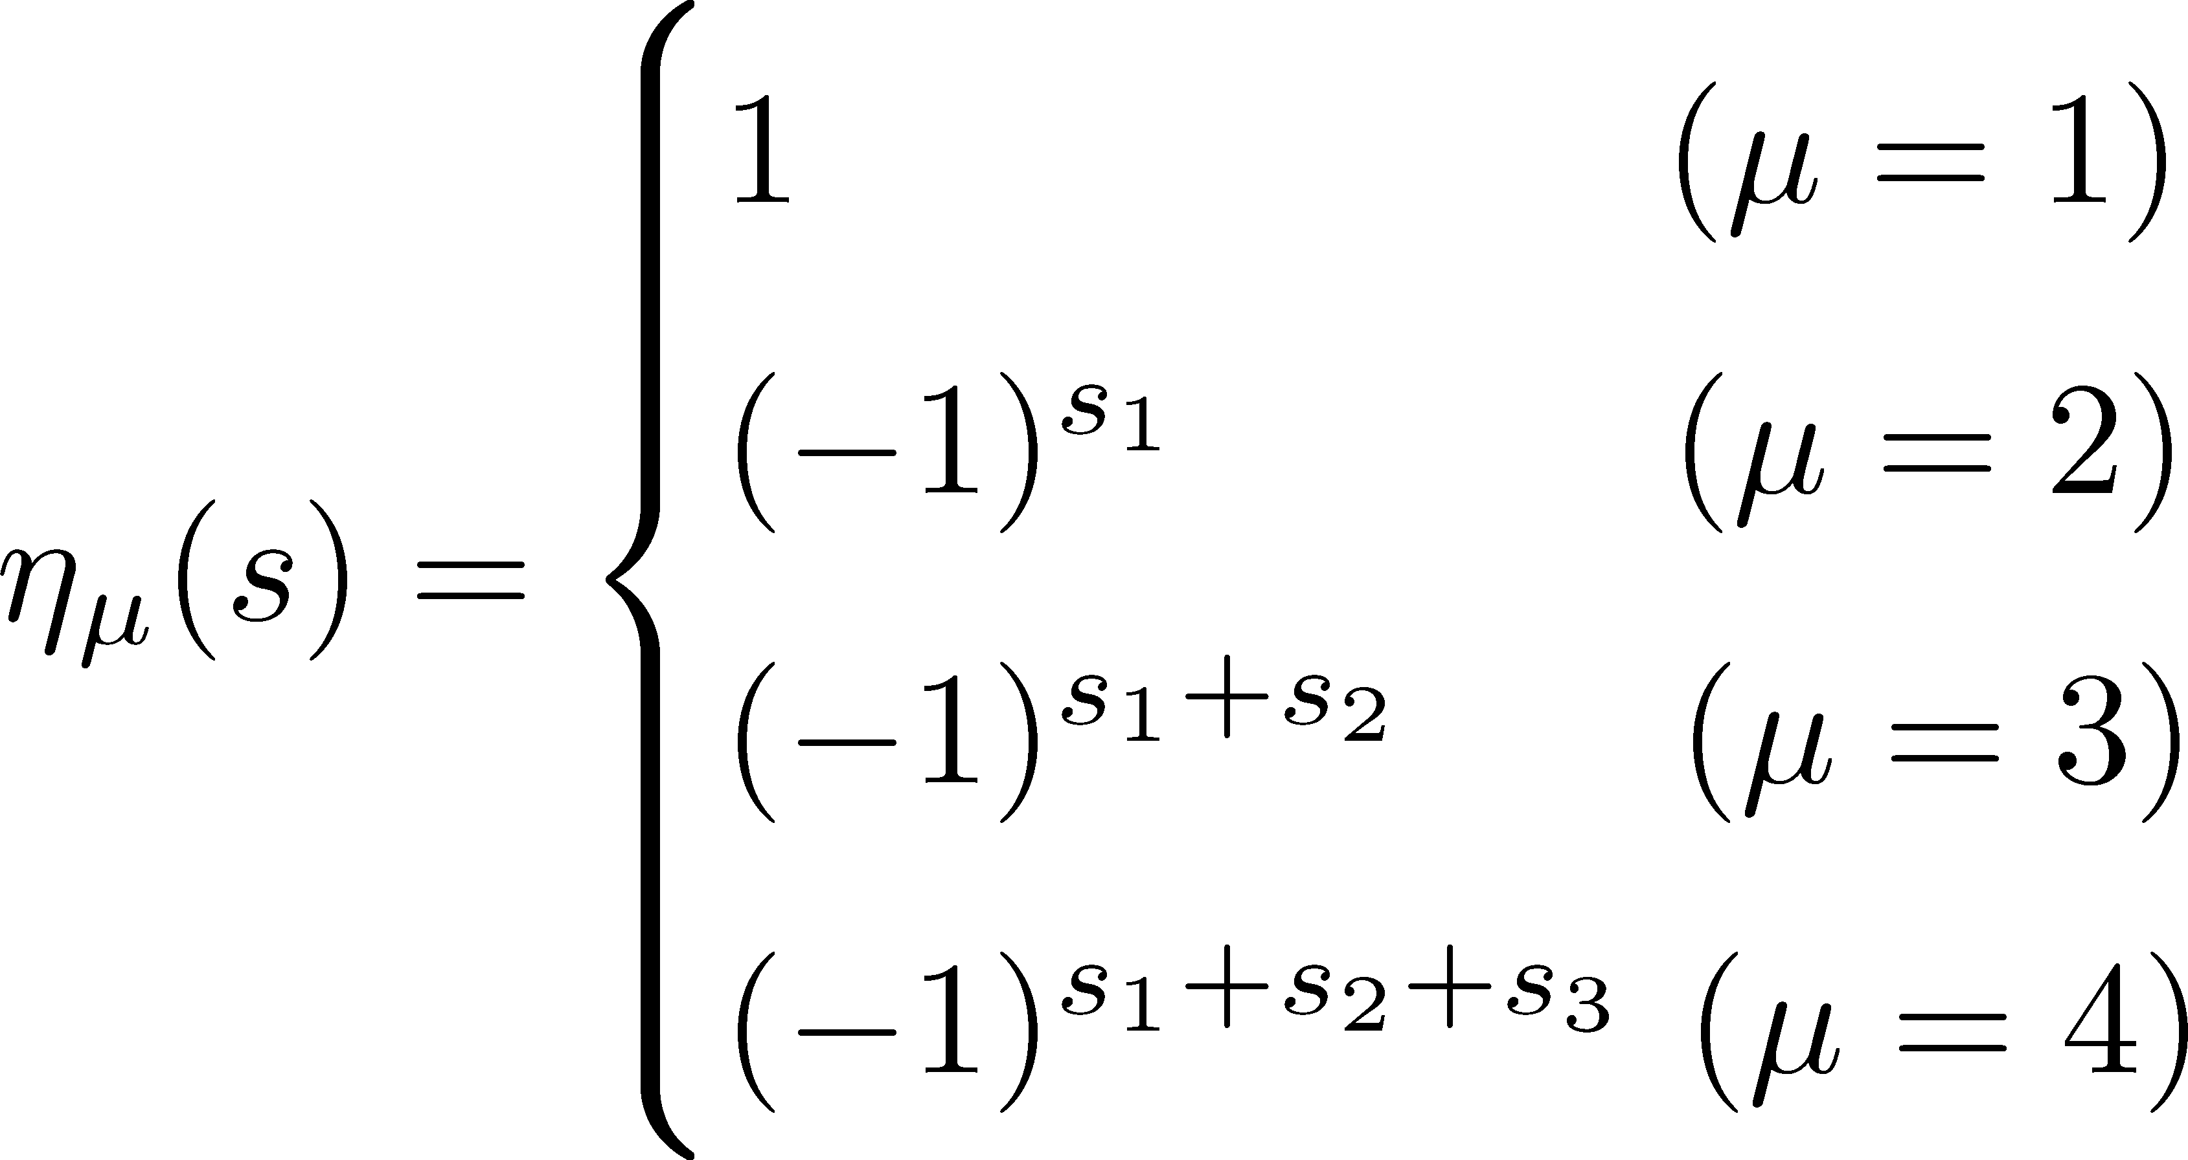
Kogut-Susskind (KS) Formalism Even Lattice
(lattice size) : even ← “even lattice”
J. B. Kogut and L. Susskind(1975)
S. Gongyo, T. Iritani, H. Suganuma(2012)
: all gamma matrices are diagonalized
staggered phase:
where KS Dirac operator

Slide 16
Kogut-Susskind (KS) Formalism Even Lattice
: even
J. B. Kogut and L. Susskind(1975)
S. Gongyo, T. Iritani, H. Suganuma(2012)
explicit form of the reduced Dirac eigenvalue equation
where
don't have spinor index
※This method is available only in even lattice.
periodic boundary condition
This requirement is satisfied only in even lattice.
for example

Slide 17
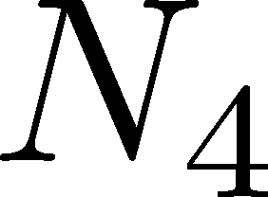
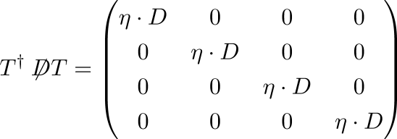
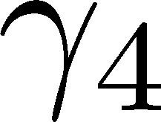
New Modified KS Formalism Temporally Odd Number Lattice
: even
case of even lattice
← “temporally odd-number lattice”
: even
: odd
We use Dirac representation( is diagonalized)
staggered phase:
where

Slide 18
New Modified KS Formalism Temporally Odd Number Lattice
: even
: odd
explicit form of the reduced Dirac eigenvalue equation
where
don't have spinor index
This method is available in temporally odd number lattice.
periodic boundary condition
This requirement is satisfied in odd lattice.
*If Not using this method, results are same.

Slide 19
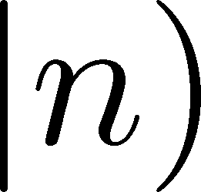
Relation between Dirac eigenmode and KS Dirac eigenmode
・・・(A)
in odd lattice
Dirac eigenmode
KS Dirac eigenmode
・・・(A)’
relation (A)’ is equivalent to (A)

Slide 20
Numerical Confirmation of Analytical Relation (A)’
・・・(A)’
(A)⇔(A)’
lattice setup
・quenched SU(3) lattice QCD
・plaquette action
・gauge coupling:
⇔
lattice spacing :
・lattice size:
・periodic boundary condition
odd
odd
For numerical confirmation of the relation (A)’,
We calculated both sides of the relation (A)’, respectively.
: left hand of (A)’ = Polyakov loop
: right hand of (A)’

Slide 21
Numerical Confirmation of Analytical Relation (A)’
・・・(A)’
(A)⇔(A)’
lattice size :
(confined phase)
configration No.
1
2
3
・・・
Polyakov loop
-0.8037 - i 8.256
-10.86 + i 11.53
-4.777 - i 7.051
・・・
right hand of (A)’
-0.8037 - i 8.256
-10.86 + i 11.53
-4.777 - i 7.051
・・・

Slide 22
Numerical Confirmation of Analytical Relation (A)’
・・・(A)’
(A)⇔(A)’
lattice size :
(deconfined phase)
configration No.
1
2
3
・・・
Polyakov loop
-163.2 - i 2.156
-164.5 + i 9.025
-155.2 – i 3.704
・・・
right hand of (A)’
-163.2 - i 2.157
-164.5 + i 9.026
-155.2 - i 3.704
・・・
for other cases, results are same.
Analytical relation (A)’ exactly holds.

Slide 23
Contribution of Low-Lying Dirac Modes to Polyakov loop
・・・(A)’
(A)⇔(A)’
Now, We can remove low-lying Dirac modes from Polyakov loop,
by removing low-lying Dirac modes from the summation over Dirac modes in right hand of (A)’
We can investigate the contribution of low-lying Dirac modes to Polyakov loop,
in other words, contribution of the essence of CSB to confinement.
← without low-lying Dirac modes
the essence of CSB
We numerically show that
low-lying Dirac modes have little contribution to Polyakov loop.

Slide 24
Contribution of Low-Lying Dirac Modes to Polyakov loop
・・・(A)’
(A)⇔(A)’
lattice size :
(confined phase)
configration No.
1
2
3
・・・
Polyakov loop
-0.8037 - i 8.256
-10.86 + i 11.53
-4.777 - i 7.051
・・・
right hand of (A)’ without
low-lying Dirac modes
-0.8090 - i 8.251
-10.84 + i 11.51
-4.782 - i 7.040
・・・

Slide 25
Contribution of Low-Lying Dirac Modes to Polyakov loop
・・・(A)’
(A)⇔(A)’
lattice size :
(deconfined phase)
configration No.
1
2
3
・・・
Polyakov loop
-163.2 - i 2.156
-164.5 + i 9.025
-155.2 – i 3.704
・・・
right hand of (A)’ without
low-lying Dirac modes
-165.8 - i 2.197
-167.3 + i 9.103
-157.8 - i 3.723
・・・
for other cases, results are same.
Low-lying Dirac modes have little contribution to Polyakov loop

Slide 26
Conclusion and Future Work
Conclusion
1.
We have derived the analytical relation between Polyakov loop and Dirac eigenmodes
in temporally odd-lattice lattice:
・・・(A)
We have also numerically confirmed this relation in each gauge configuration
in lattice QCD both in confined and deconfined phases.
Thus, one-to-one correspondence does not hold between confinement and CSB in QCD.
2.
We have found new Modified KS formalism available in temporally odd-number lattice
as well as in even lattice:
,
Future Work
・This relation in continuum limit
・consider not only Polyakov loop but also other quantity about confinement, such as
Wilson loop and monopole in Maximaly Abelian gauge.

