Slide 1
6E-1
Phase structure of topological insulators by lattice strong-coupling expansion
Yasufumi Araki
(The Univ. of Texas at Austin)
[1] YA and T. Kimura, Phys. Rev. B 87, 205440 (2013)
[2] A. Sekine, T. Z. Nakano, YA and K. Nomura, Phys. Rev. B 87, 165142 (2013)
Jul. 29 - Aug. 3, 2013: Lattice 2013 @ Mainz, Germany

Slide 2
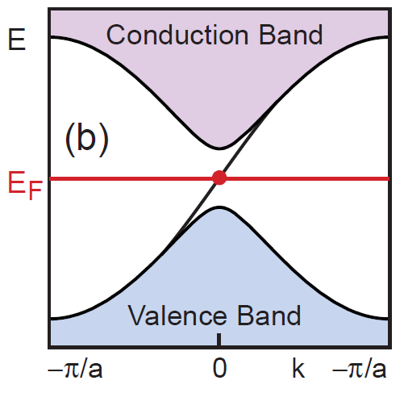
Topological insulators
“Insulator”
Conduction band and valence band are separated by a large bandgap.
“Topological”
Wave function of electron is characterized by nontrivial topology.
e.g.) Topological invariant - Chern number (Z, Z₂,...)
Existence of massless chiral fermions:
surface states (3D)
edge states (2D) - carries anomalous/spin Hall current
2005: Theoretical prediction - Kane, Mele
2007: First observed in HgTe - Konig et al.
Hasan, Kane (2010)

Slide 3
This work
Question:
Effect of e-e interaction on the topological nature?
cf.) (Eff. theory of) graphene (2D massless Dirac fermion)
Exciton condensate
Analogy to “chiral symmetry breaking” in QCD
Drut, Lahde (2009) Araki, Hatsuda (2010)
spontaneous gap generation (in the bulk)
Changes the topological band structure in TIs…?
Apply lattice gauge theory …
TIs can be described in terms of Wilson fermions.
e-e interaction in terms of QED = U(1) gauge theory.
[1] 2D topological insulators (Kane-Mele model on honeycomb lattice)
[2] 3D topological insulators (Wilson fermion on square lattice)
Topological phase structure changes from noninteracting systems.

Slide 4
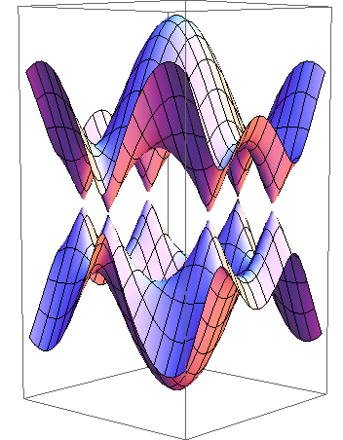
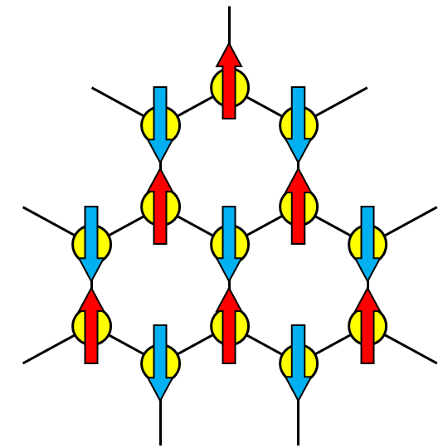
2D lattice fermions
Fermions on honeycomb lattice (e.g. graphene):
“Dirac cone” structure around two Dirac points K±.
Wallace(1947)
Two Dirac nodes are degenerate: “doublers”
Physical interpretation of the “mass term”
K
K’
= staggered magnetic field: m
A-site favors ↑. / B-site favors ↓.
induces antiferromagnetism in z-direction.
momentum independent: nontopological mass term

Slide 5
2D topological insulators
Kane-Mele model
Kane, Mele (2005)
Spin-orbit interaction (t’) is incorporated on the honeycomb lattice.
Leads to “effective mass” term in the bulk
becomes a “topological insulator”
characterized by quantum spin Hall effect
K
K’
Momentum-dependent mass term
Degeneracy of Dirac nodes is split by spin-orbit interaction.
Analogy to the Wilson term

Slide 6
Topological phase structure
Non-interacting system:
Kane, Mele (2005)
m
Normal insulator (Uniform SDW)
K
K’
Topological insulator (Quantum spin Hall)
t’
In the presence of e-e interaction…?

Slide 7
QED on honeycomb lattice
[1]
Incorporate e-e interaction mediated by electromagnetic field.
Define QED on honeycomb lattice - apply Lattice gauge theory.
Araki (2011), Giuliani et al. (2012), Buidovich et al. (2012)
Electrons:
(x,y) : defined on honeycomb lattice.
τ : discretize by Δτ like staggered fermions.
Electromagnetic field:
τ
Link variables between lattice sites.
Kinetic term: given as a sum of plaquettes.
proportional to “inverse coupling”:
(~0.04: graphene)

Slide 8
Strong coupling expansion
(1) Expand the partition function by β (strong coupling expansion).
(2) Integrate out the link variables.
Decompose into short-range interaction terms.
O(β⁰): on-site interaction
~ Lattice version of Hubbard model.
(3) Introduce bosonic auxiliary fields.
(Extended Hubbard-Stratonovich transformation)
(4) Integrate out the fermionic fields.
Effective potential F(σ; m, t’)

Slide 9
Order parameters
σ₁(=z-direction)
t’, m
|σ| : imbalance between two sublattices
θ : direction in the U(1) spin subspace
σ : antiferromagnetism (spin density wave)
σ₂(=x-direction)
t’ and m breaks spin symmetry in z-direction explicitly.
σ₁ and σ₂ should be distinguished.

Slide 10
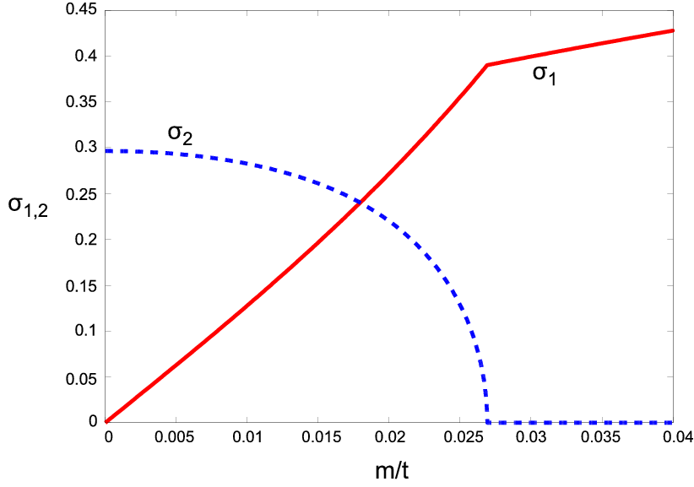
Behavior of order parameters
Fix t’=0.5t’_{C} / Vary m=0→∞.
σ₂≠0 for small m.
σ₁→∞, σ₂=0 for m→∞.
tilted
normal

Slide 11
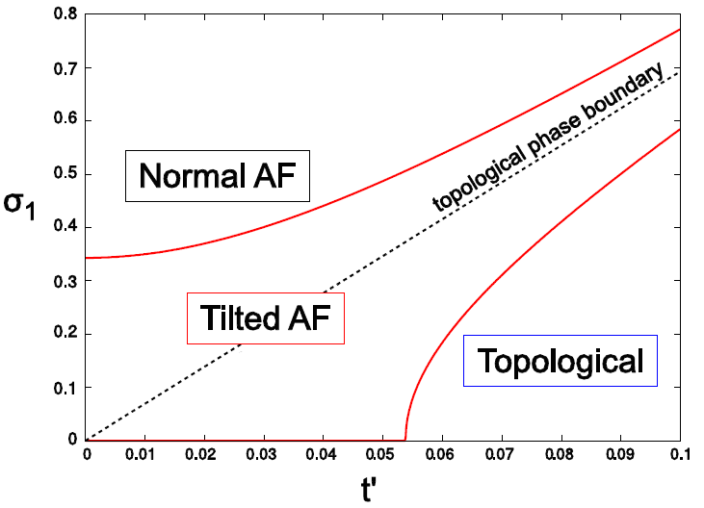
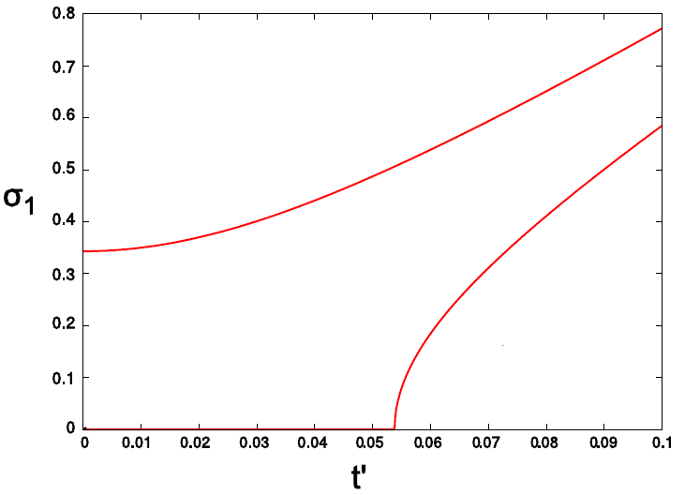
Phase diagram
(σ₂=0)
(instead of m)
(σ₂=0)
(σ₂≠0)
New phase (Tilted AF) appears by the effect of e-e interaction.
Notes:
experimental

Slide 12
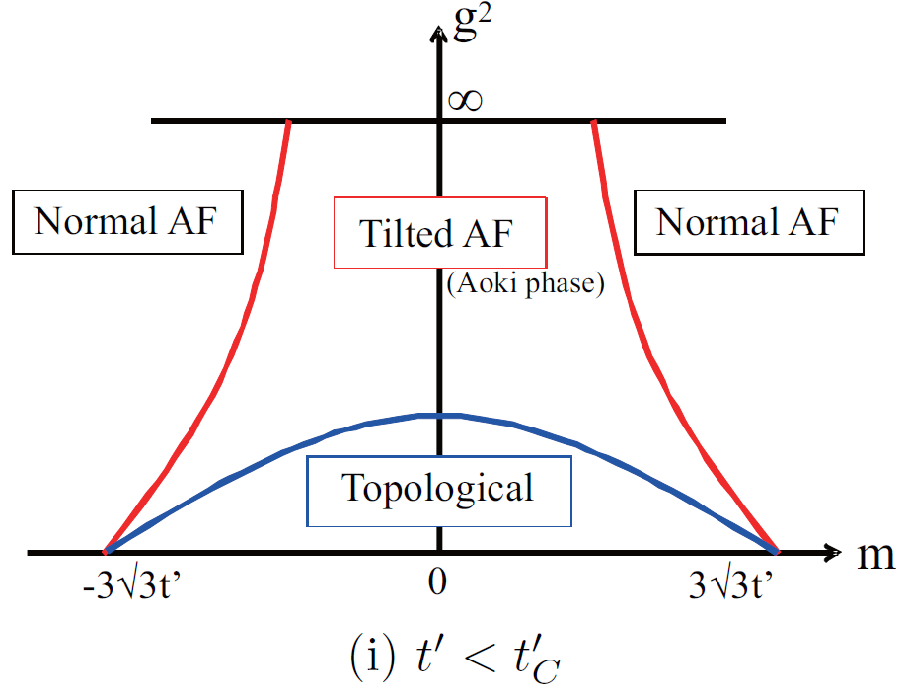
Analogy to Lattice QCD
 | 2D TIs | Lattice QCD
effective mass | spin-orbit interaction (t’) | Wilson term (r)
splits degeneracy of | valleys (2) | doublers (16)
explicitly breaks | U(1) remnant spin symm. | (continuous) chiral symm.
Induced phase | Tilted AF phase | Aoki phase
characterized by | (nematic AF) | (pion condensation)
 | both orthogonal to the explicit breaking direction.
Phase structure of topological insulators can be conjectured from lattice QCD...?

Slide 13
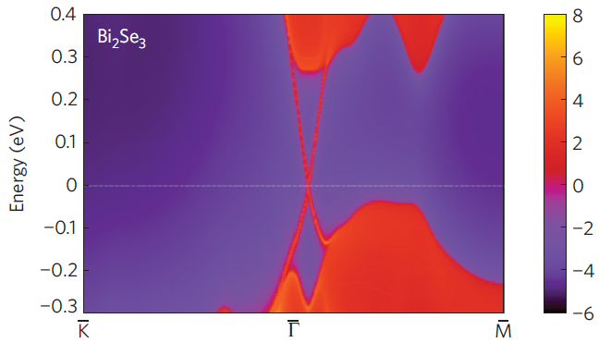
3D topological insulator
[2]
2D TI: single Z₂ invariant (Chern number)
3D TI: four Z₂ invariants
various topological phases
3D TIs (e.g. Bi₂Se₃) are described phenomenologically by Wilson fermions:
Zhang et al. (2009)
-2r < m₀ < 0: “strong topological insulator”
e-e interaction defined by QED (U(1) lattice gauge theory)
Strong coupling expansion + Mean-field analysis
Effective potential F(φ_{σ},φ_{π})
“pseudospin ferromagnetism”

Slide 14
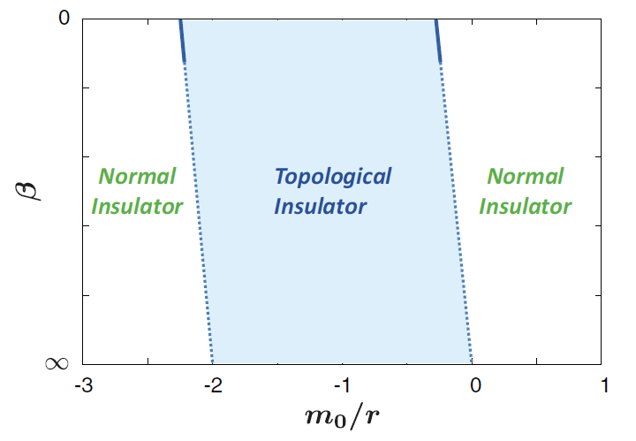
Phase structure
〈φ_{π}〉 vanishes everywhere in the phase diagram.
TI/NI transition is characterized by effective mass
Strong coupling limit
(r: fixed)
Noninteracting limit
- TI state persists in the strong coupling region.
- TI/NI transition is shifted by the e-e interaction.

Slide 15
Summary
The effect of e-e interaction on topological insulators is investigated.
TI band structure can be described in terms of Wilson fermions.
Topological phase structure is shifted by the strong e-e interaction:
2D: new phase (“Tilted AF”) appears between TI/NI transition.
3D: TI persists at strong coupling; phase boundary is shifted.
Change of physical properties under the phase transition…?
anomalous (spin) Hall conductivity, existence of surface states, …
Analogy to lattice QCD phase structure…?
existence of “pions”?

Slide 16
Backup slides

Slide 17
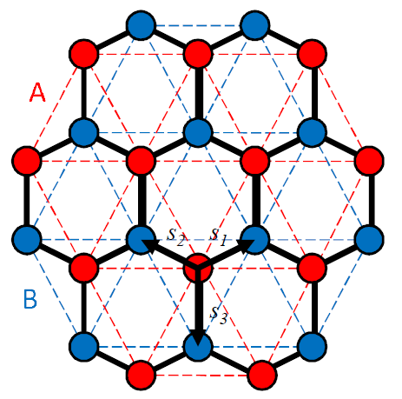
Band strcture of graphene
Tight-binding Hamiltonian:
E
“Dirac cone” structure at long wavelength.
Wallace(1947)
... around two Dirac points K±.
Gapless “semimetal” at half-filling.
k_{x}
k_{y}

Slide 18
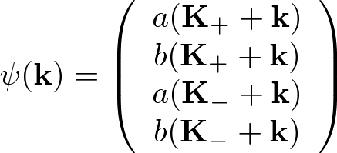
Effective field theory
Sec. 2.1
Tight-binding Hamiltonian:
λ: sublattice / τ: valley

Slide 19
Reduced QED
Sec. 2.2
Scale transformation:
Saddle point approximation:
Spatial components (=retardation) can be neglected.

Slide 20
Introducing a bandgap
Staggered magnetic field:
Apply a spatially periodic magnetic field so that
A-site favors ↑. / B-site favors ↓.
Opens a finite gap m at each Dirac point.
(Topology of the ground state is trivial.)

Slide 21
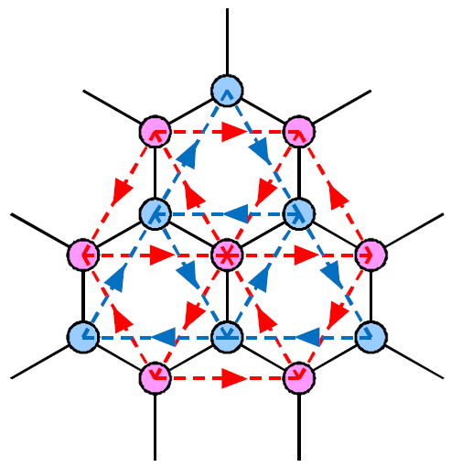
Kane-Mele model
Second-NN hopping = spin-orbit interaction
Opens a gap
at each Dirac point.
Sign of “mass” depends on valley (Dirac point) index:
+M_{SO} around K₊ ; -M_{SO} around K₋
Nontrivial topology of the ground state w.f.

Slide 22
Doubling problem and spin symmetry
Sec. 2.3
Imaginary time is discretized by lattice spacing Δτ.
Pole of fermion propagator appears at ω=π/Δτ
as well as at ω=0.
Number of d.o.f. is doubled: Doubling problem
Nielsen, Ninomiya (1981)
To retain the physical d.o.f.:
(i) remove the spin index.
(ii) treat doublers as spin d.o.f. (staggered discretization)
Spin SU(2) is restricted to U(1). (defined in the (z,x)-plane)
i.e. Full spin symmetry is intrinsically broken.
Remnant U(1) spin is broken by SDW (antiferromagnetism).

Slide 23
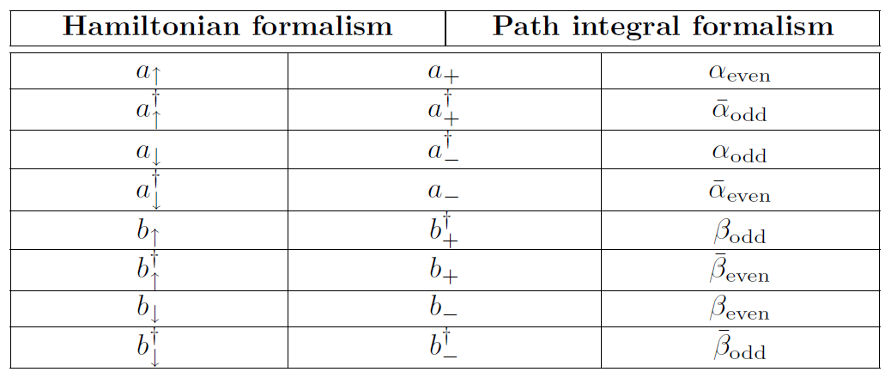
Spin and staggered representation
App. A
eigenvalue of S_{y}.

Slide 24
Strong coupling expansion
Expansion by β (strong coupling expansion) is valid.
(β=0: strong coupling limit)
O(β⁰)
O(β¹)
O(β⁰): on-site interaction
O(β¹): NN interaction
Short-range interaction terms are derived systematically.

Slide 25
Strong coupling limit
[O(β⁰)]: On-site 4-Fermi term is generated.
~ Lattice version of Hubbard model.
Bosonic auxiliary fields: (Extended Hubbard-Stratonovich transf.)
Remnant U(1) spin:
σ serves as an order parameter for
sublattice / spin symmetry breaking.
= Antiferromagnetism (Spin Density Wave)

Slide 26
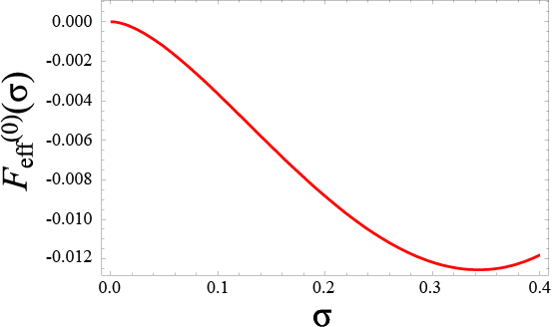
Spontaneous symmetry breaking
Thermodynamic potential: (mean field ansatz)
Dirac cone structure leads to log-singularity at σ=0.
Phase of σ can be chosen arbitrarily in remnant U(1).

Slide 27
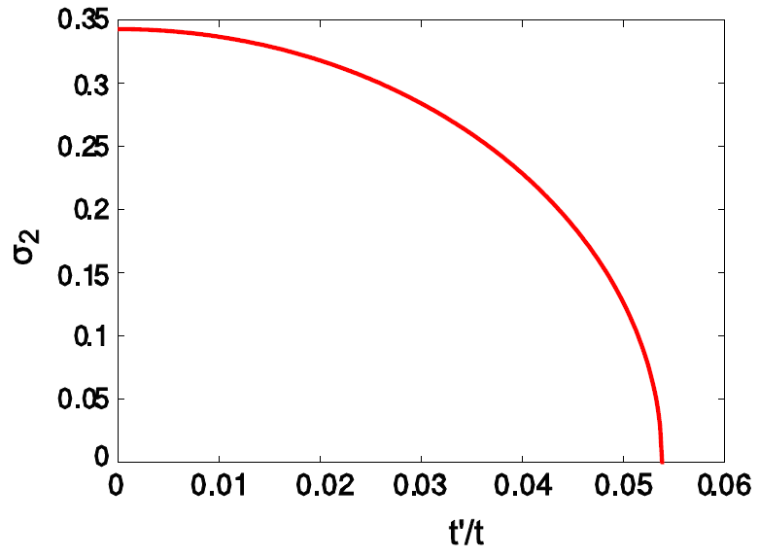
Effect of spin-orbit interaction t’
In the absence of staggered magnetic field m:
Two Dirac cones interrupt each other in σ₁-direction.
σ₁ vanishes at the potential minimum.
Log singularity is moderated by the SOI gap.
Order parameter σ₂ gets suppressed as t’→∞.
(2nd order)

Slide 28
Physics of Tilted AF phase
z
σ₁
source: m, t’
U(1) remnant spin symmetry
SU(2) full spin symmetry
NG mode?
Normal AF
Tilted AF
y
σ₂
x
Physics of NG mode:
transport properties (QHE,QSHE), ...?

Slide 29
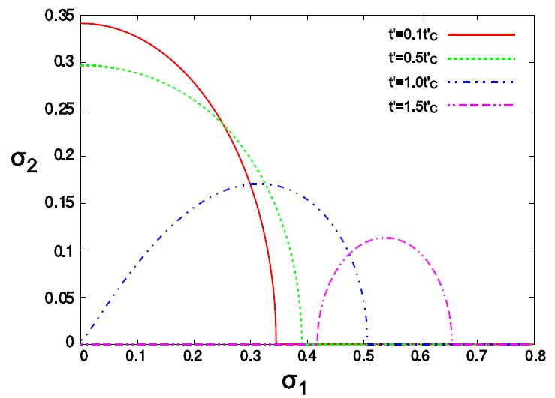
Trajectory of potential minimum
Sec. 3.4.2
Fix t’ and vary m: 0→∞:
〈σ₁〉 is induced by m explicitly. (one-to-one correspondence)
〈σ₂〉 vanishes at a certain m (or σ₁).

Slide 30
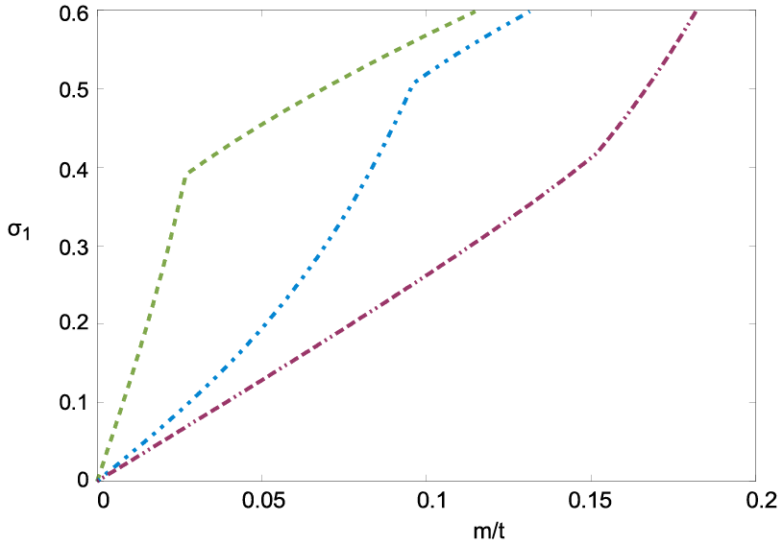
Trajectory of potential minimum
Sec. 3.4.2
t’=0.5t’_{C}
t’=1.5t’_{C}
t’=1.0t’_{C}
σ₁ monotonically increases as a function of m.

Slide 31
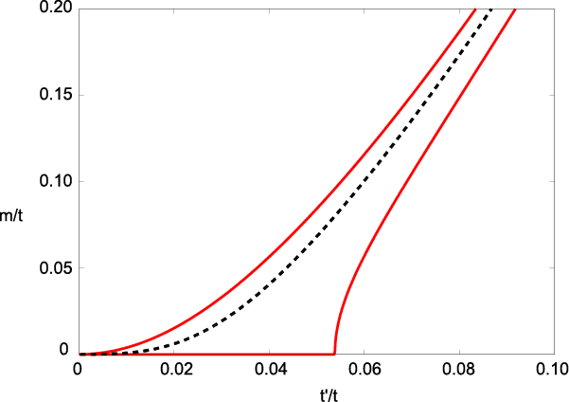
Phase structure
Sec. 3.4.2
Parametrize by (t’,m):
Normal AF
Topological
Tilted AF

Slide 32
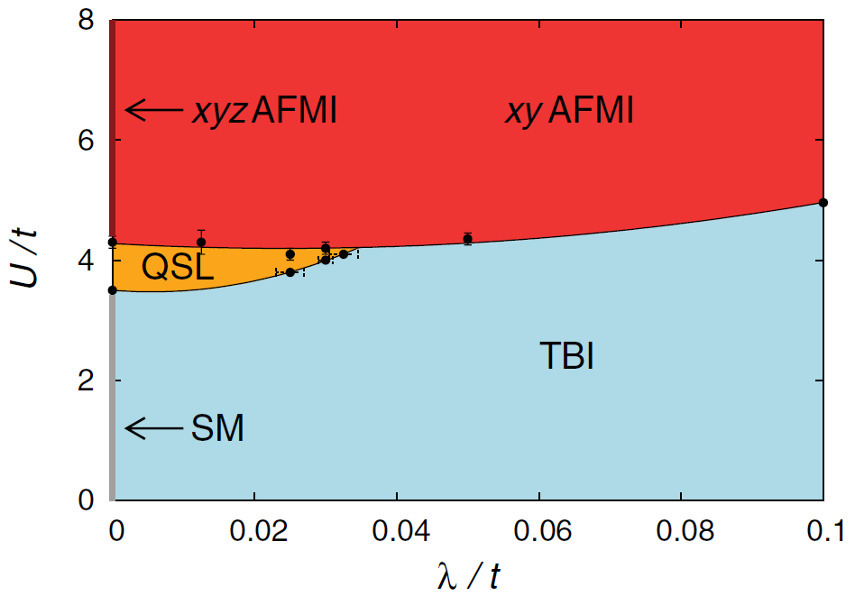
Relation to previous studies
Monte Carlo simulations of Kane-Mele-Hubbard model:
(xy-antiferromagnetic insulator = “Tilted AF”)
(Topological band insulator)
Hohenadler et al. (2012)
Our result corresponds to U→∞ limit with m-axis.

Slide 33
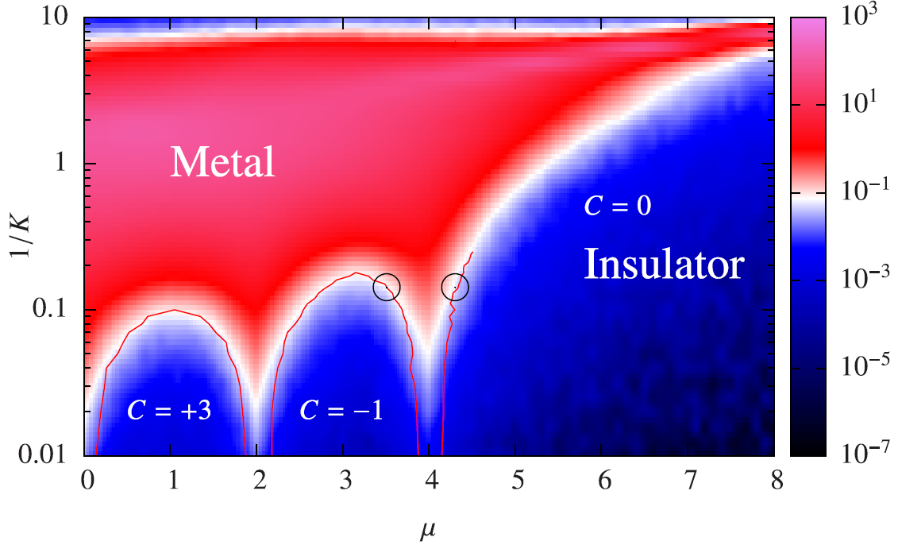
4D Quantum Hall system
Sec. 3.4.2
mean displacement
J. M. Edge et al. (2012)
C=0 Insulator: Normal insulator
C≠0 Insulator: Topological insulator
Metal: Tilted AF? (effect of NG mode?)

Slide 34
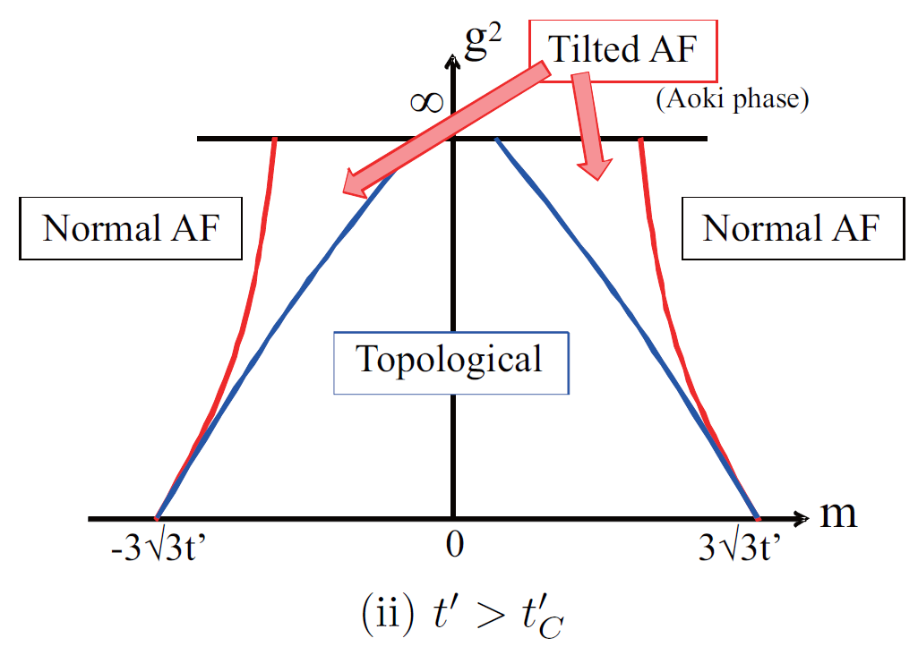
Conjecture from lattice QCD
Phase structure of topological insulators can be conjectured from lattice QCD...?

